Slide 1
Hibernate Application Development & CRUD Operations

Slide 2
Objectives
Data Management
Implement CRUD (Create, Read, Update, Delete) operations to manage data effectively.
Utilize Hibernate to map Java objects to database tables, simplifying data persistence and retrieval.
User Interface Development
Design and develop a user-friendly interface using JavaFX, enabling seamless interaction with the application.
Implement features such as form input validation, error handling, and feedback mechanisms to enhance user experience.

Slide 3
Build CRUD Application with Repository Pattern using Hibernate

Slide 4
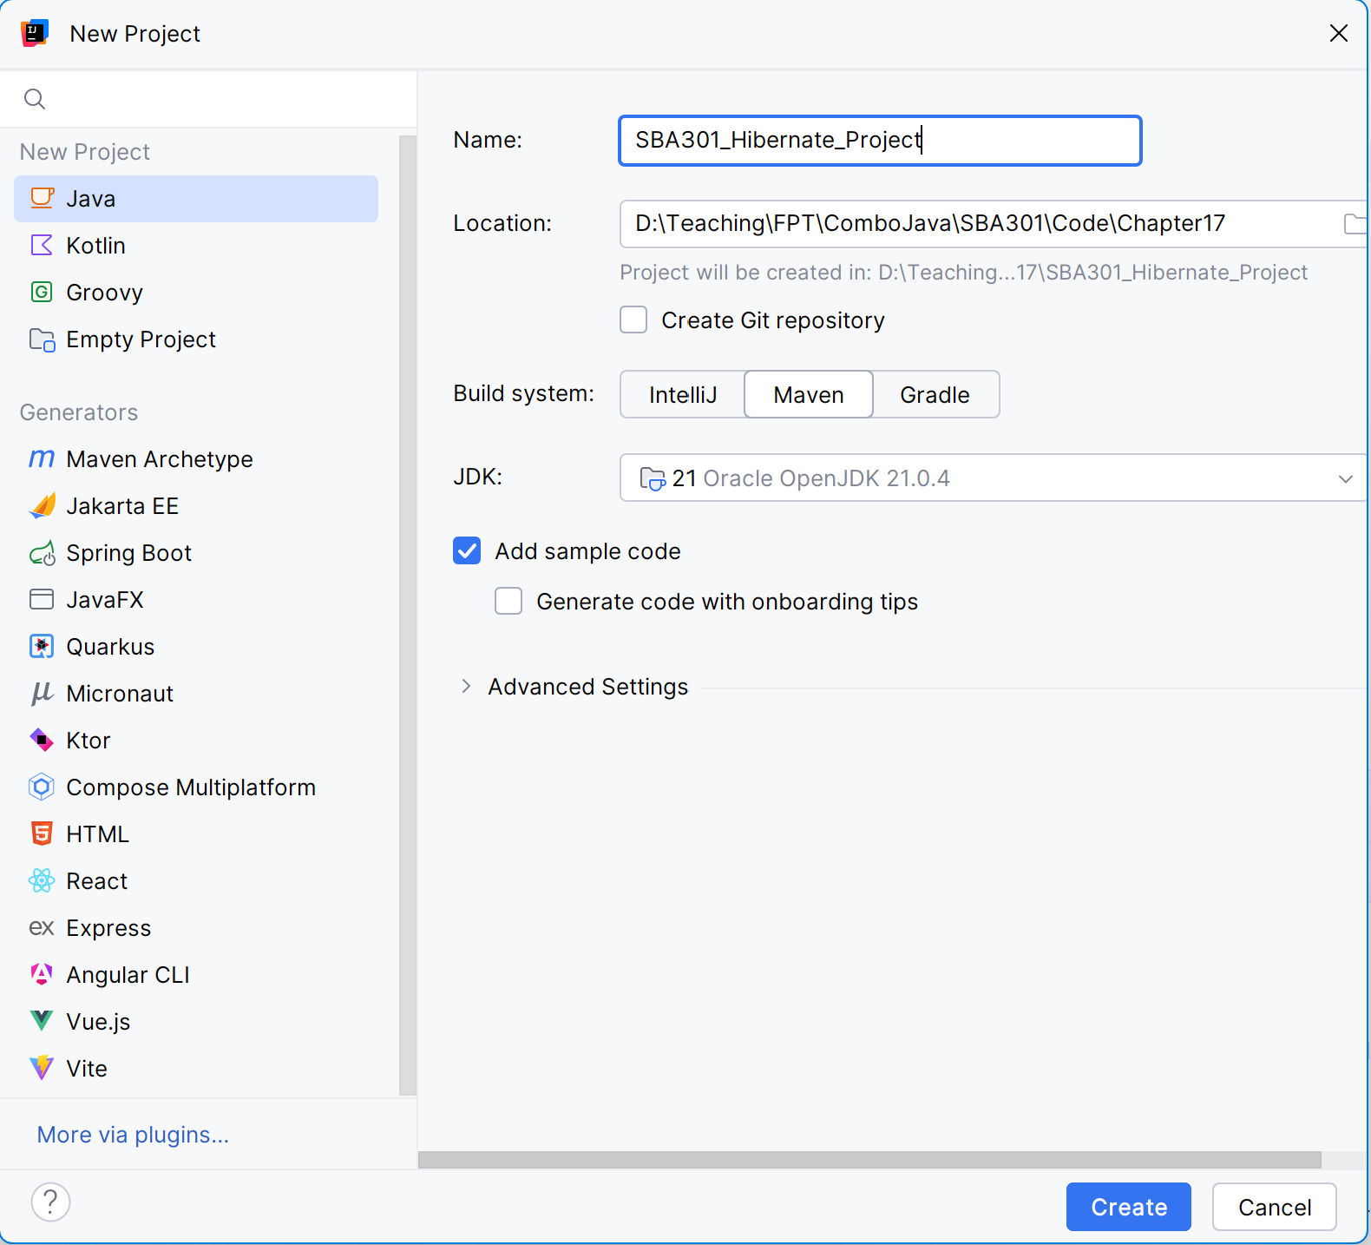
File New Project SBA301_Hibernate_Project

Slide 5
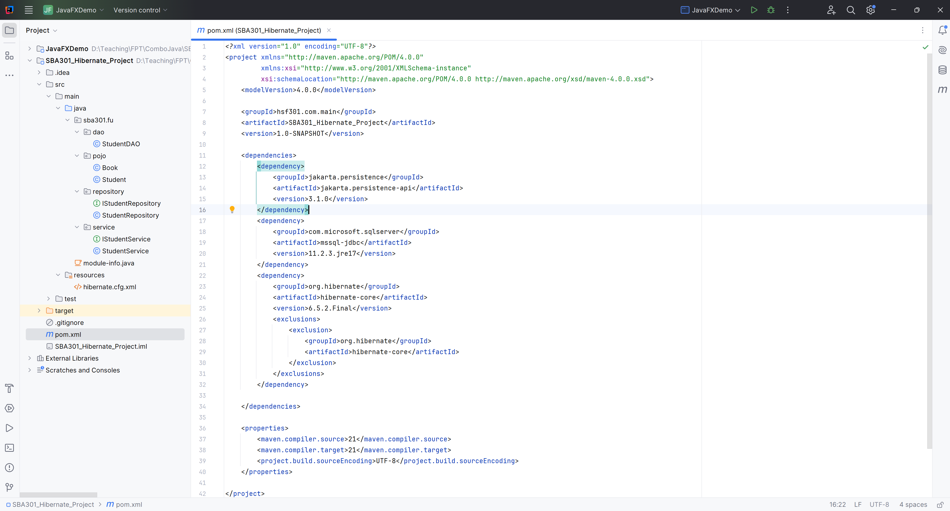
Create the Structure Project

Slide 6
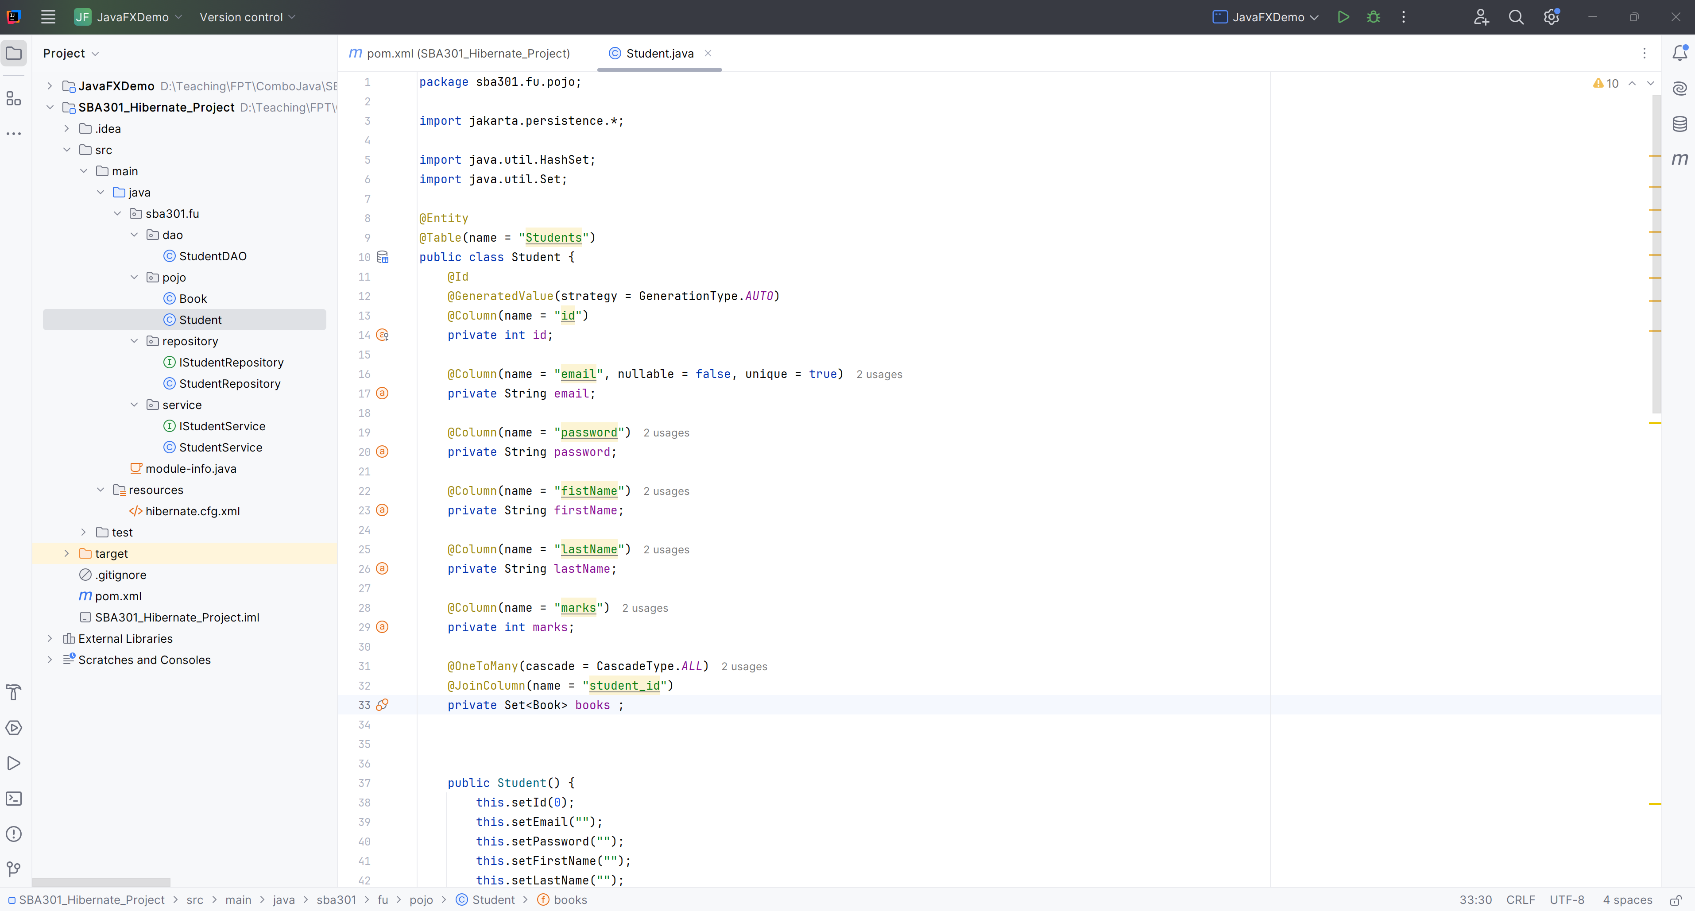
Create Student.java

Slide 7
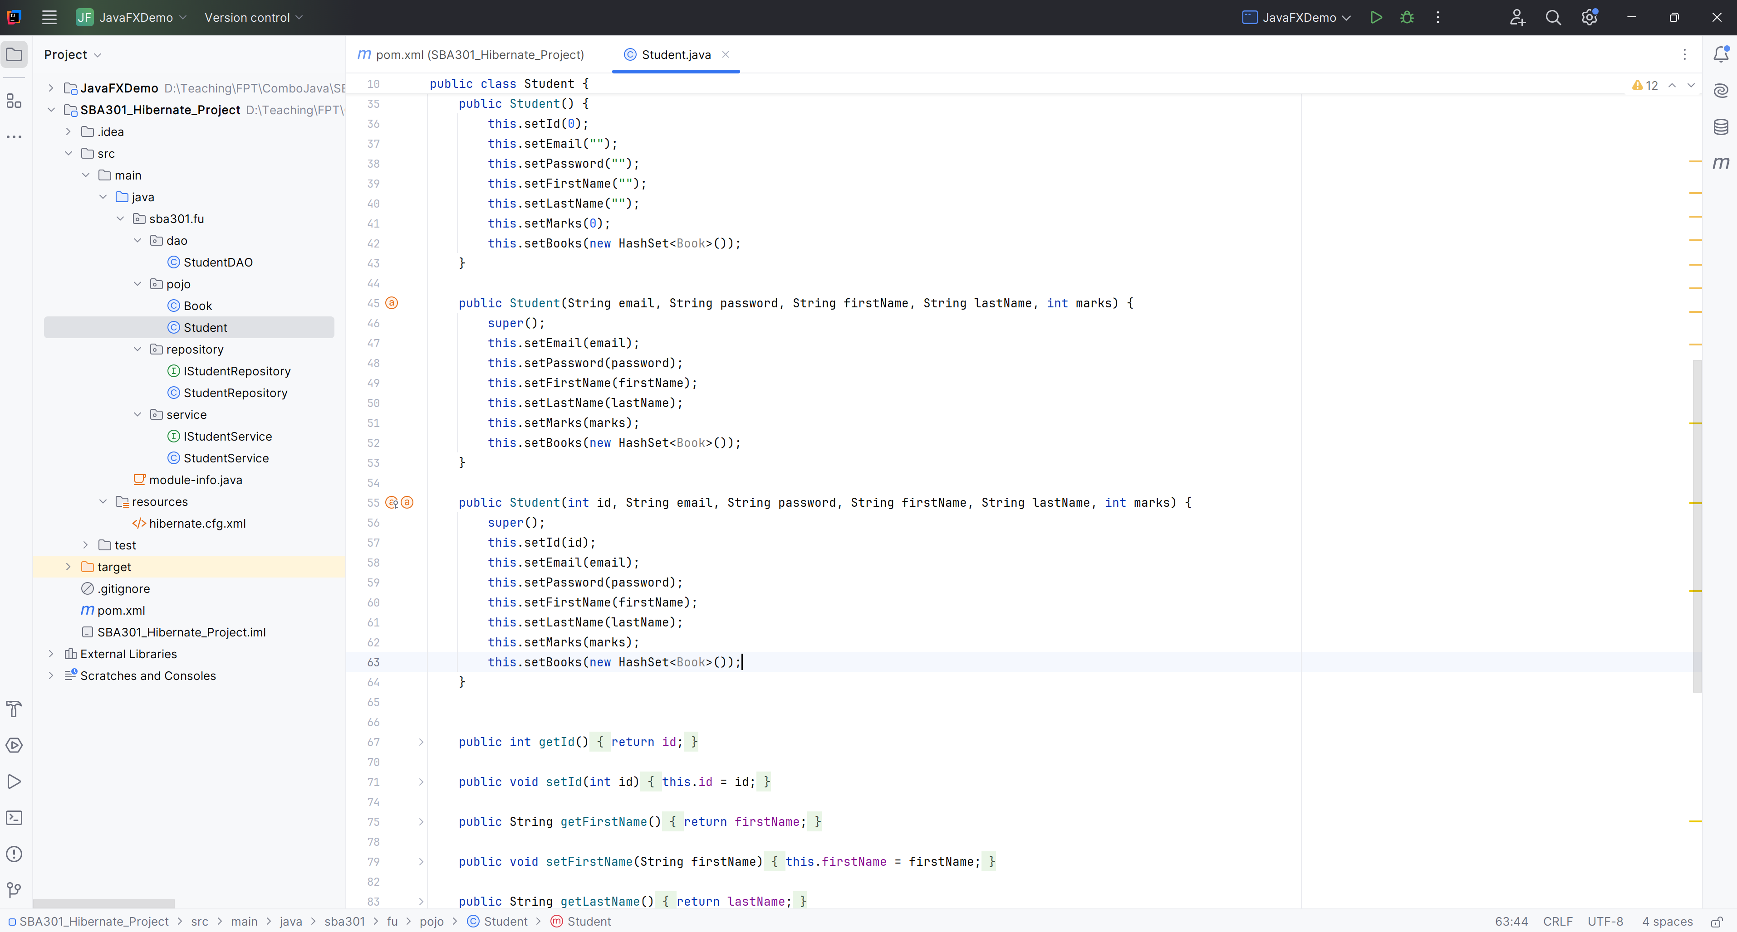
Create Student.java

Slide 8
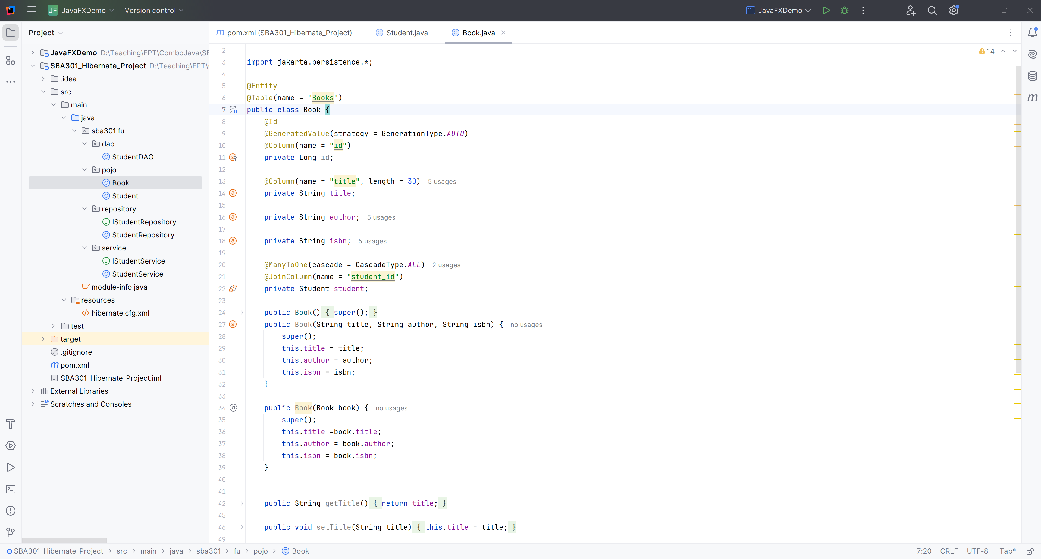
Create Book.java

Slide 9
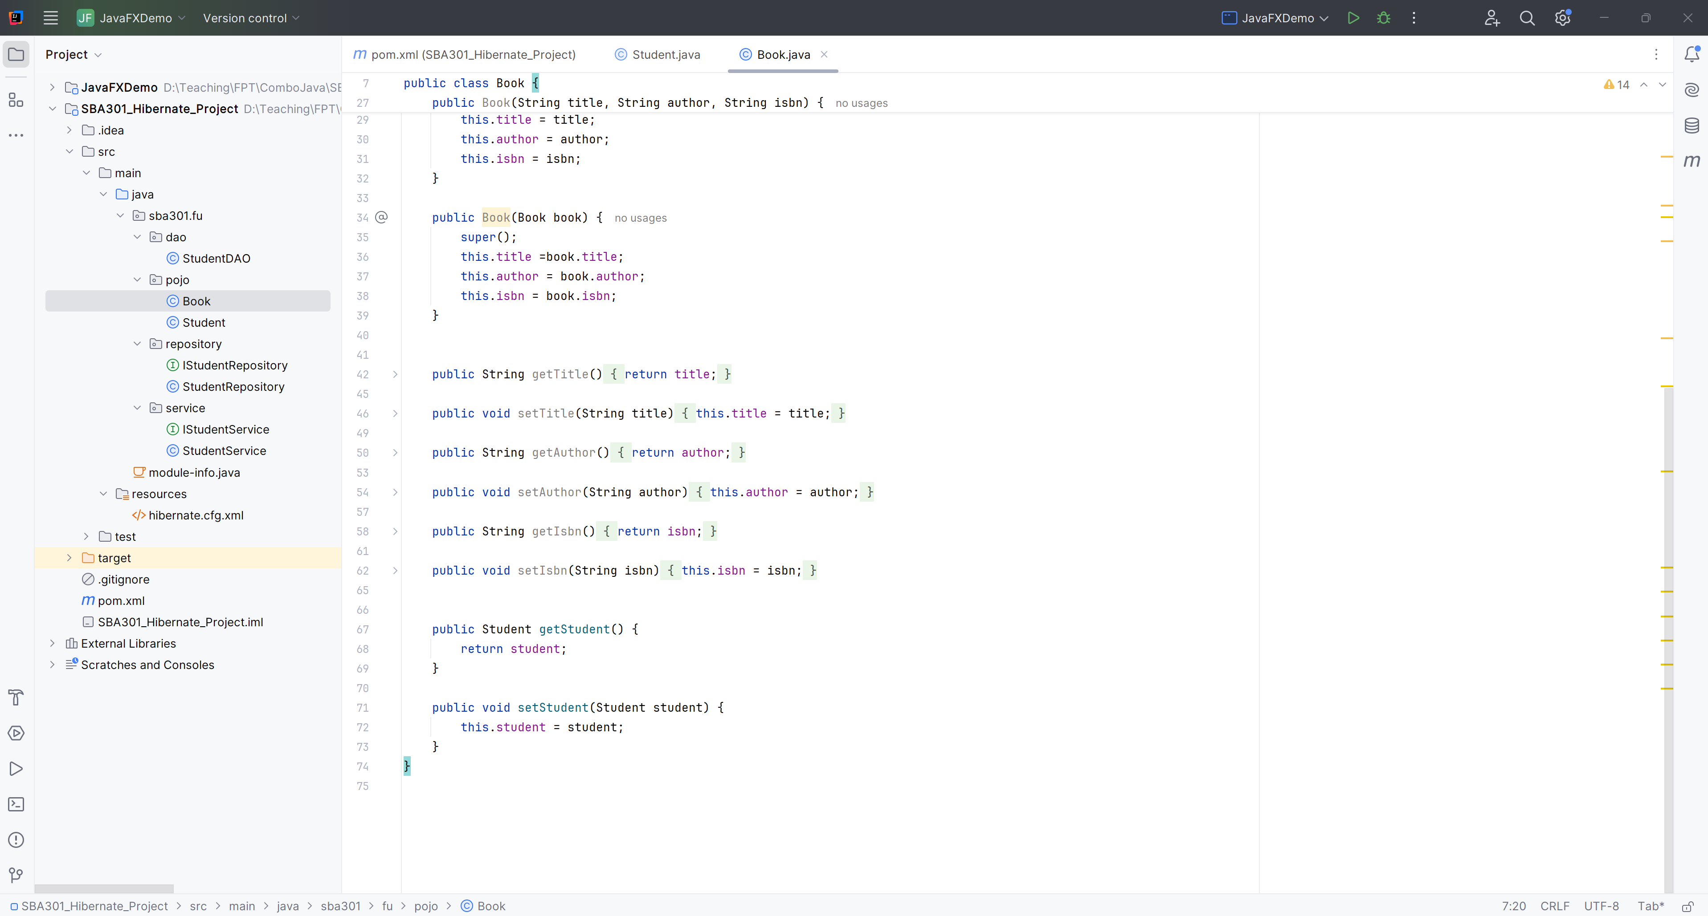
Create Book.java

Slide 10
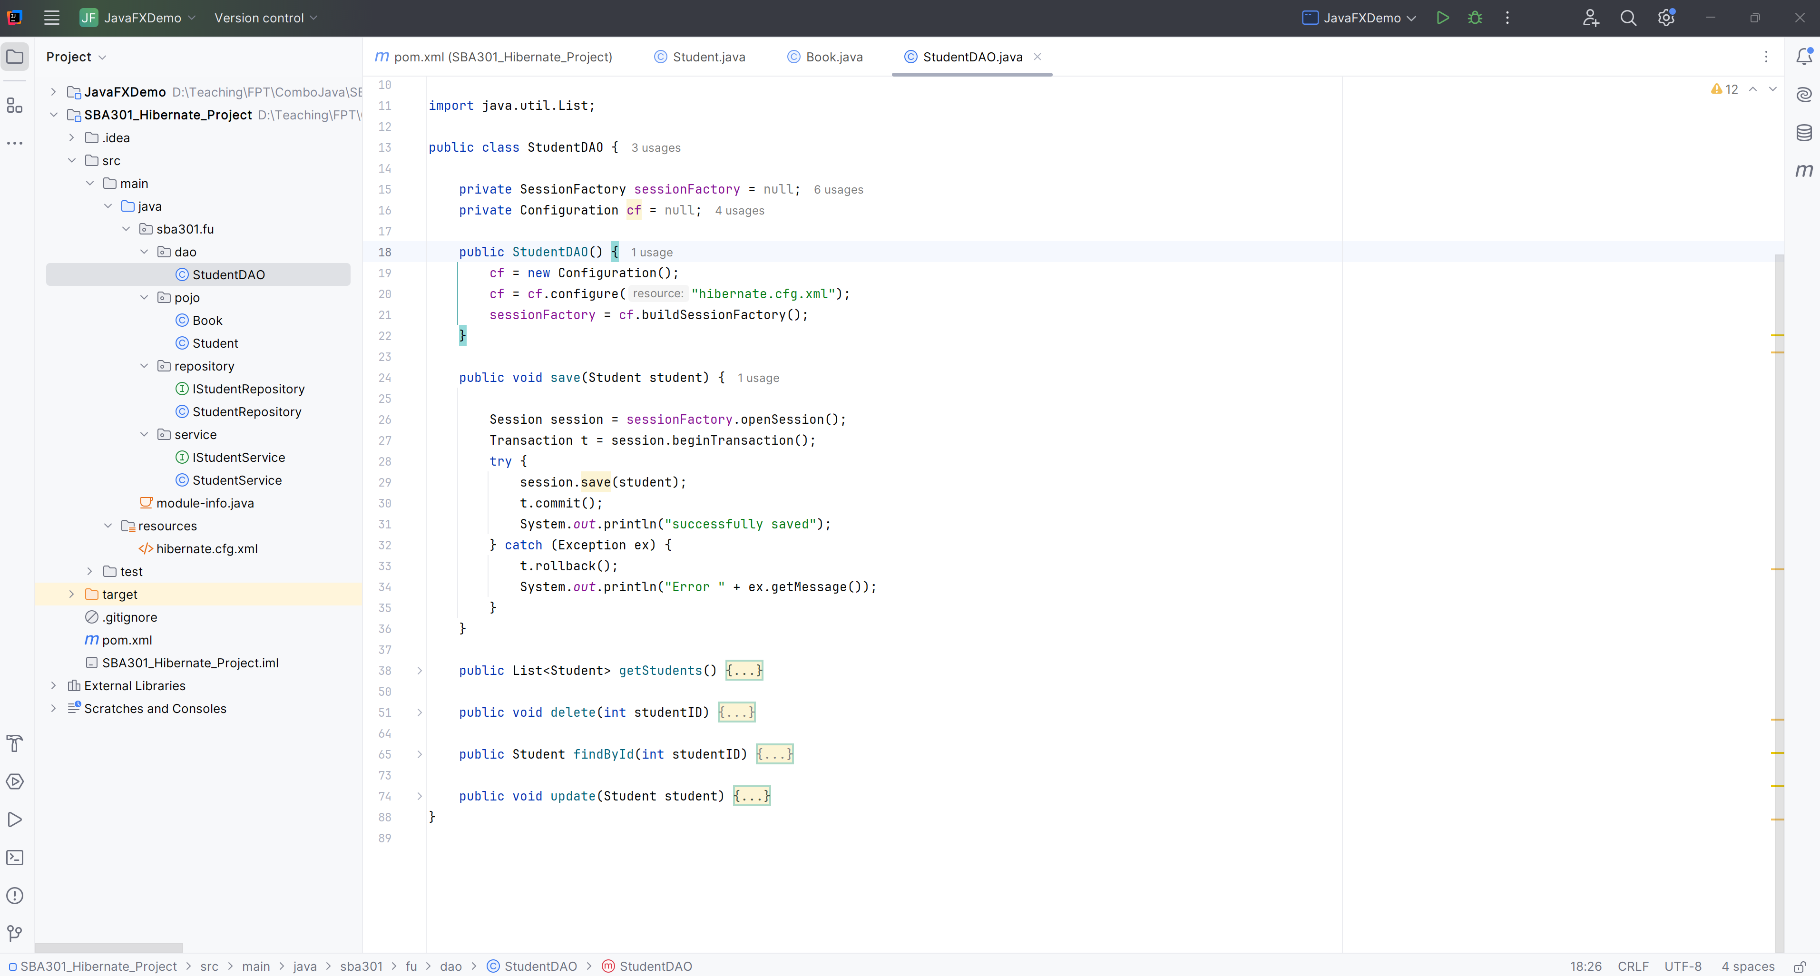
Save Student in StudentDAO

Slide 11
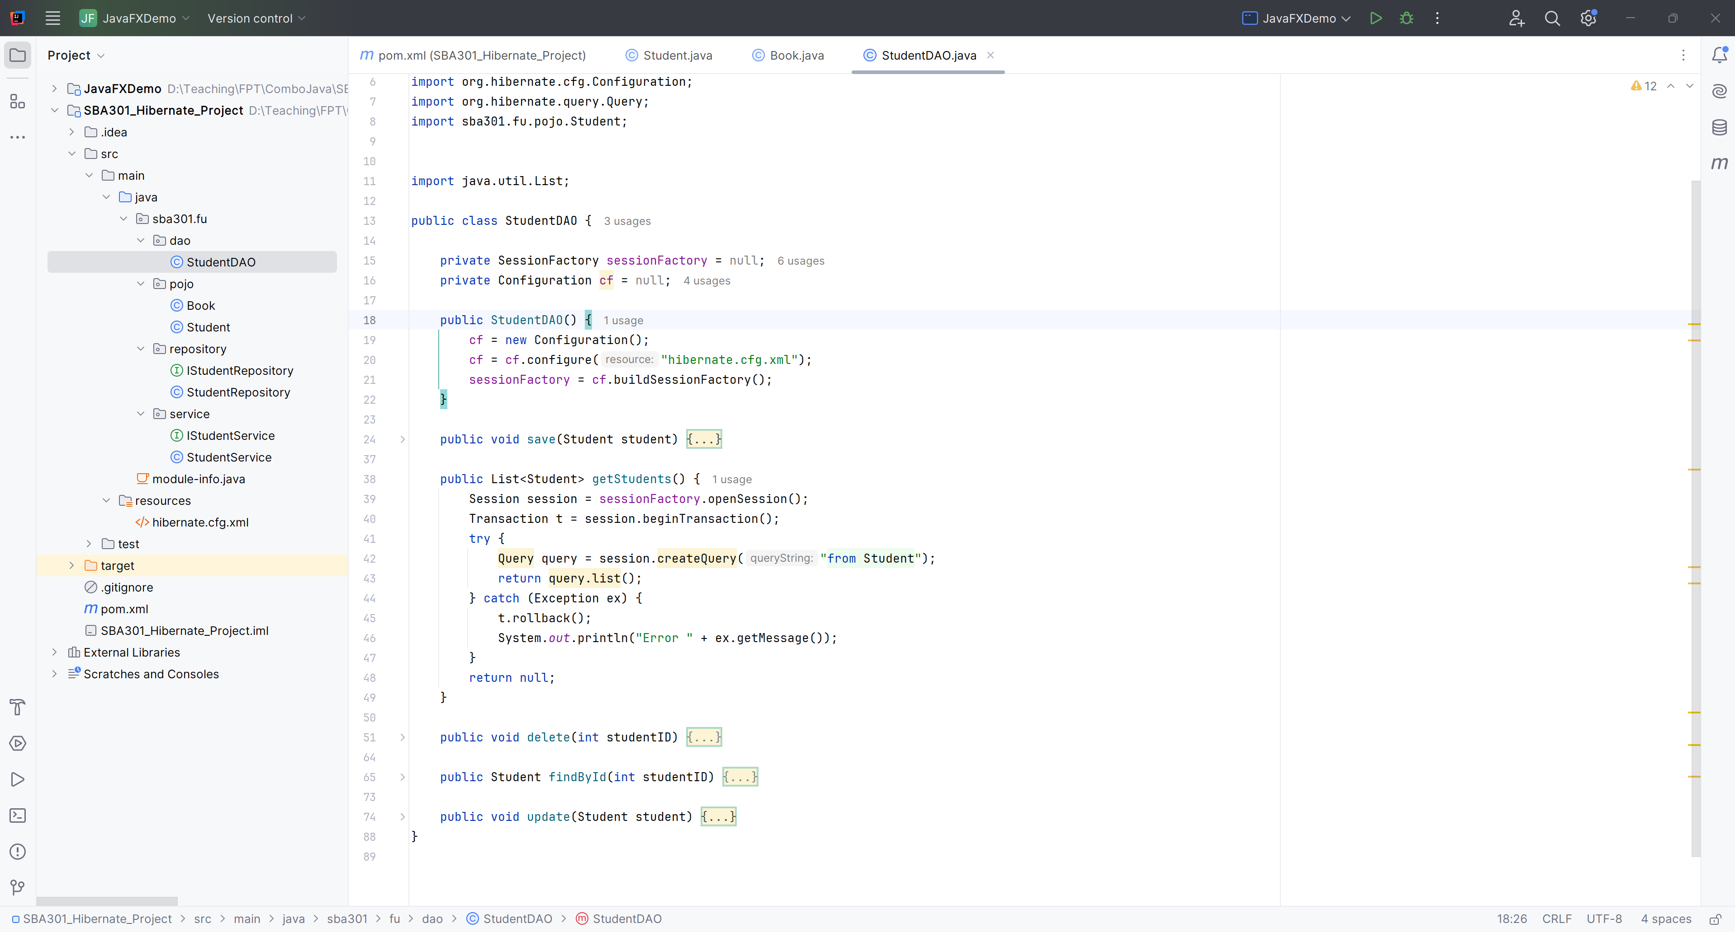
Get All Student in StudentDAO

Slide 12
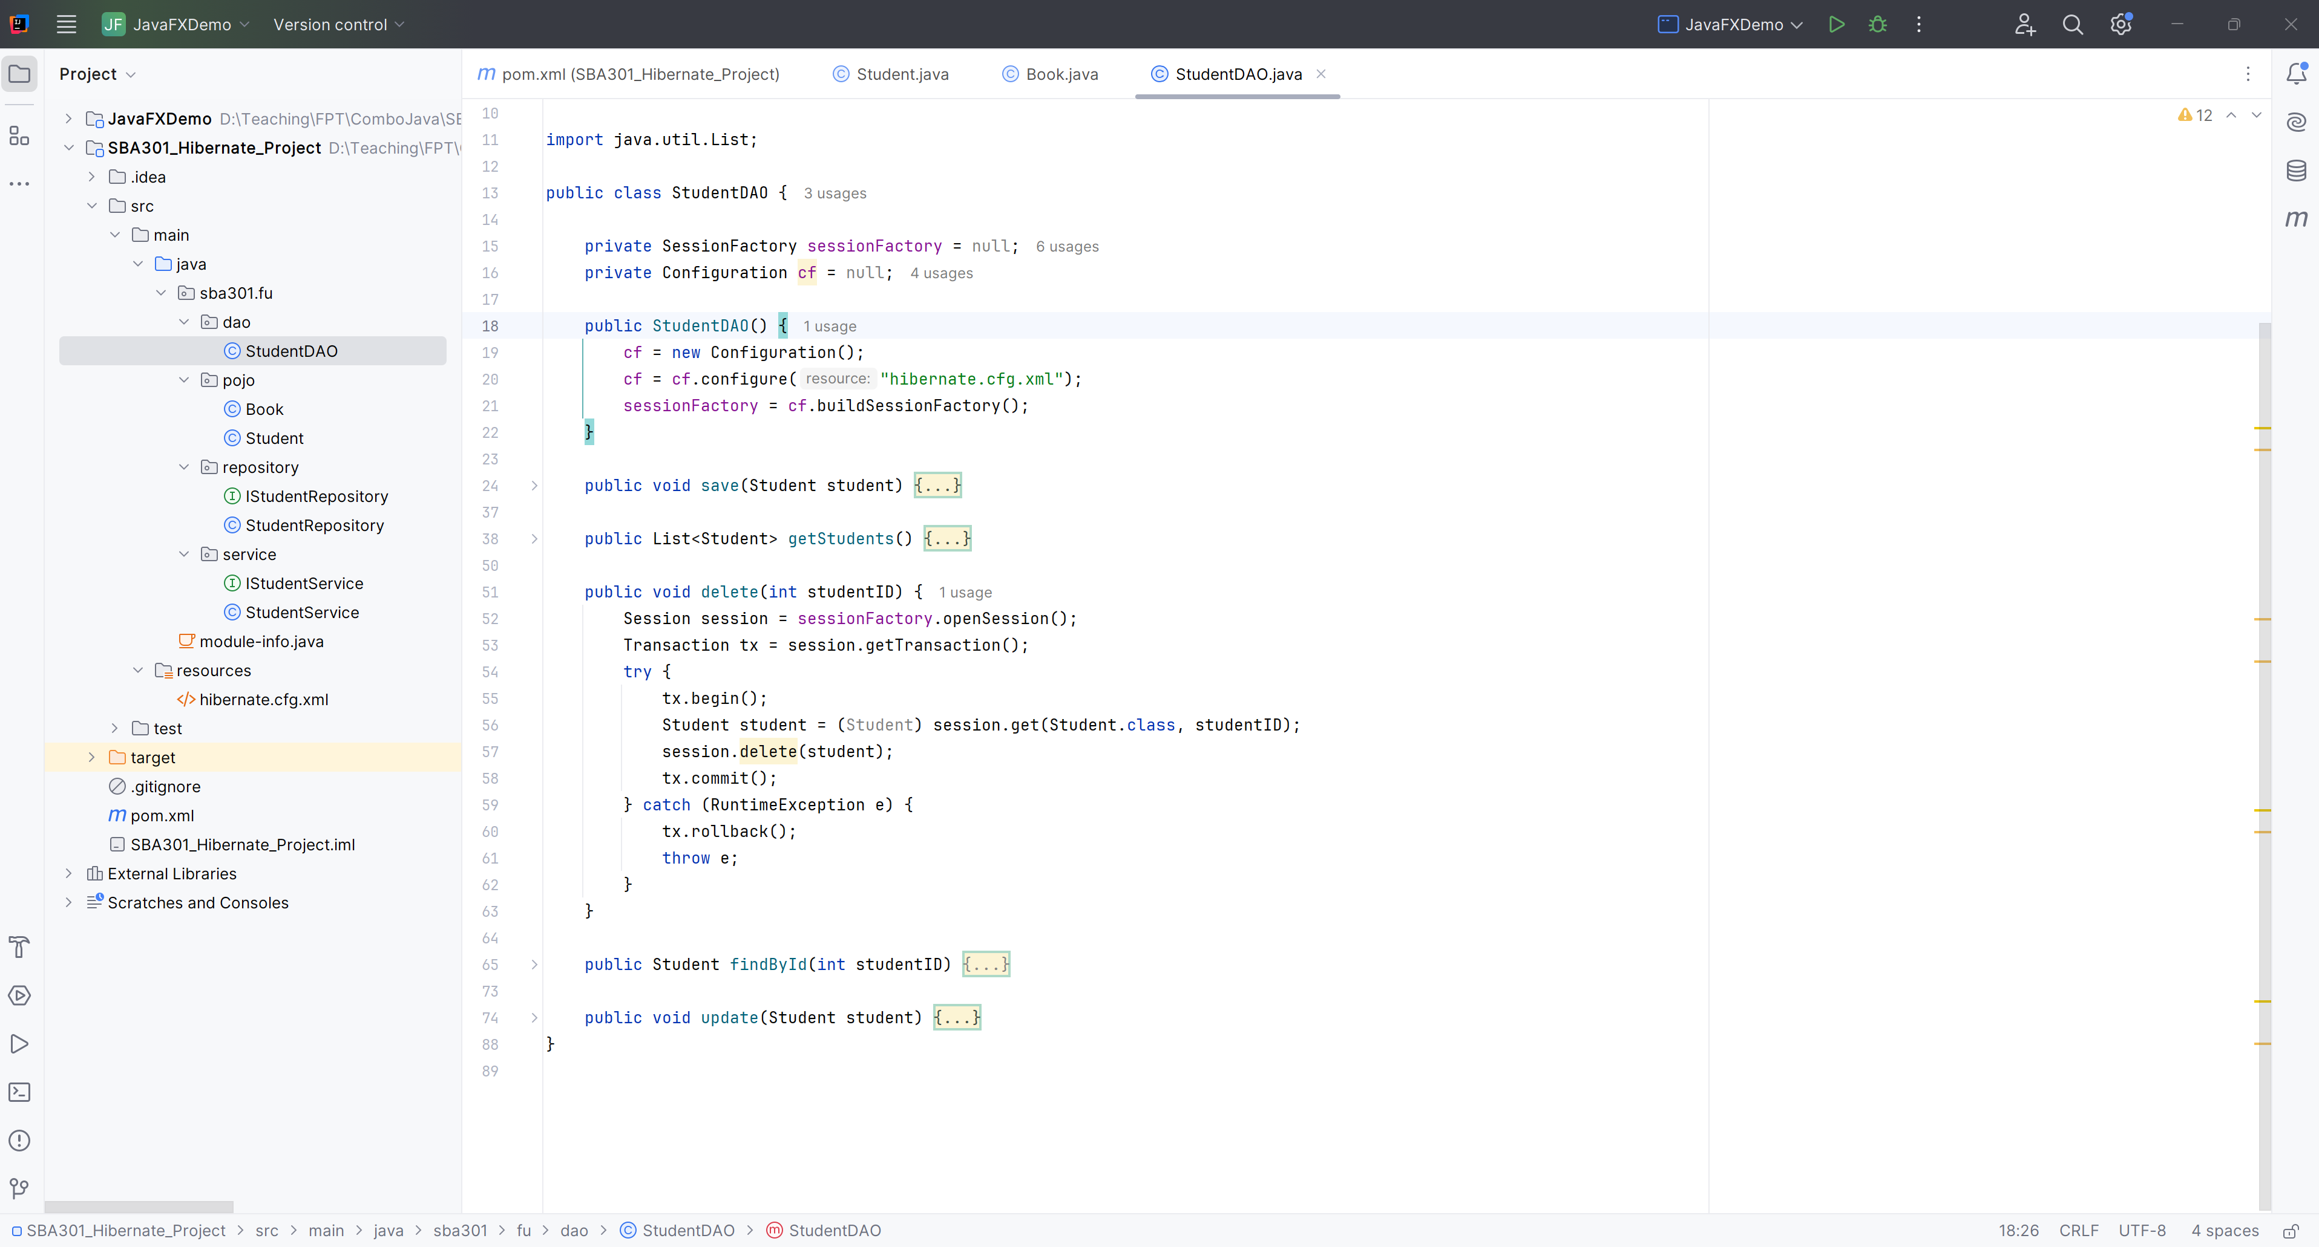
Delete Student in StudentDAO

Slide 13
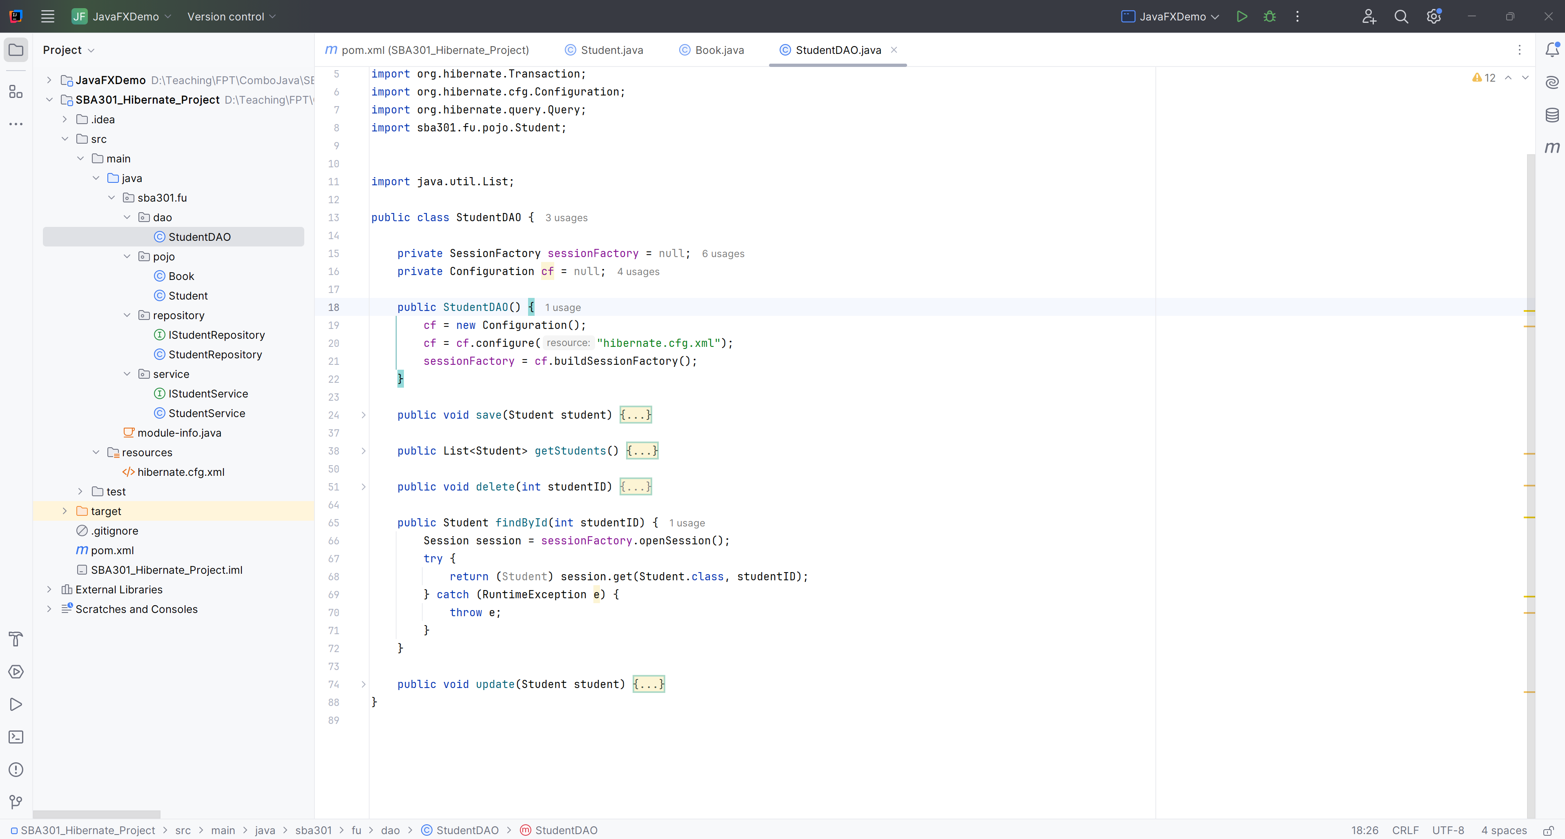
Find A Student in StudentDAO

Slide 14
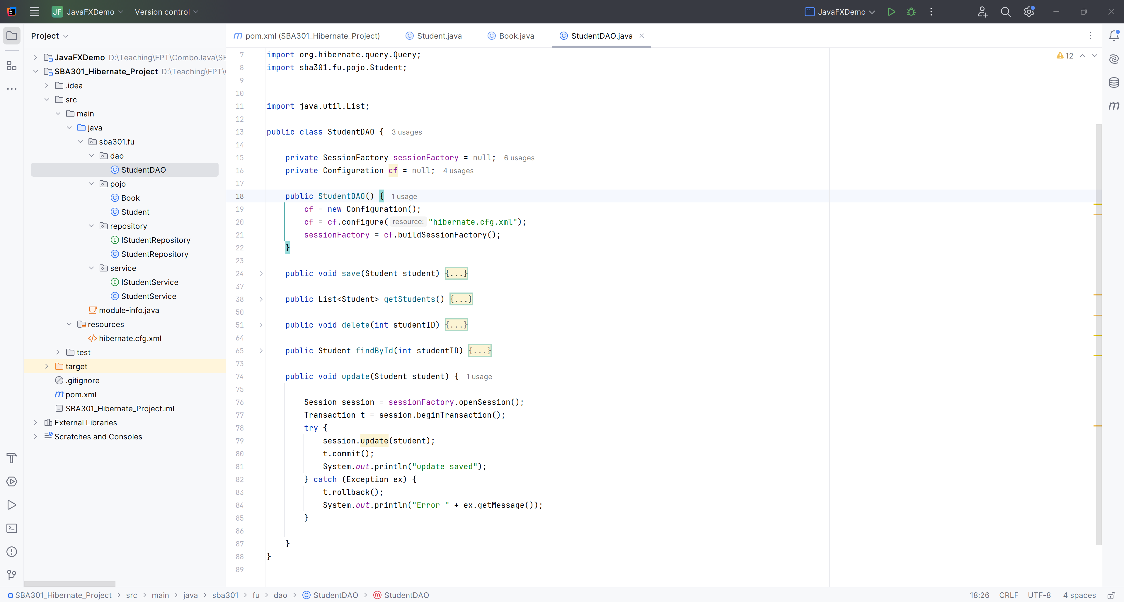
Update a Student in StudentDAO

Slide 15
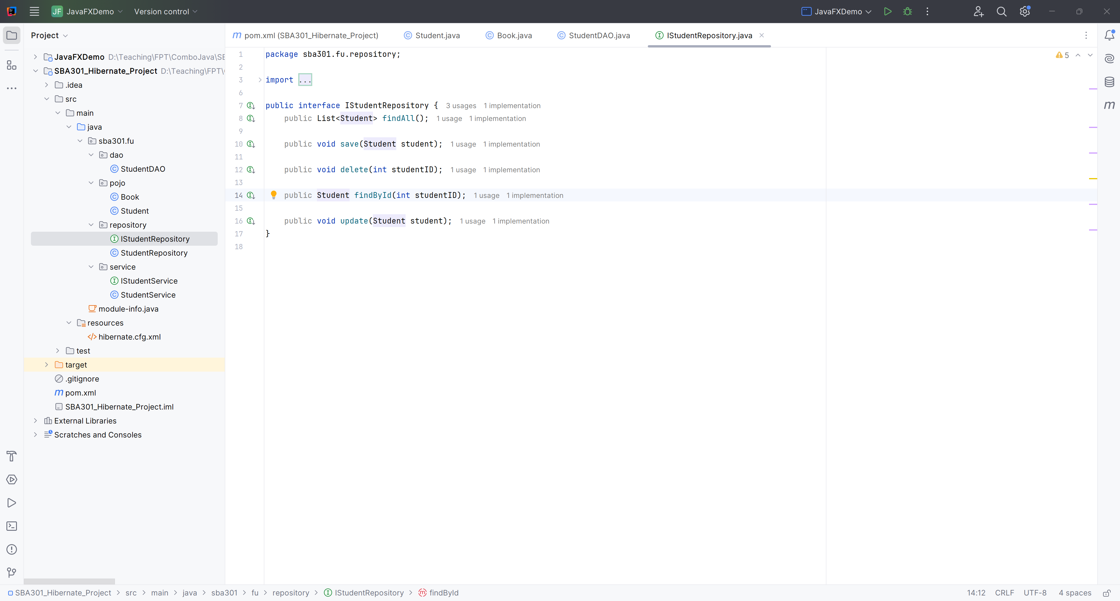
Create IStudentRepository

Slide 16
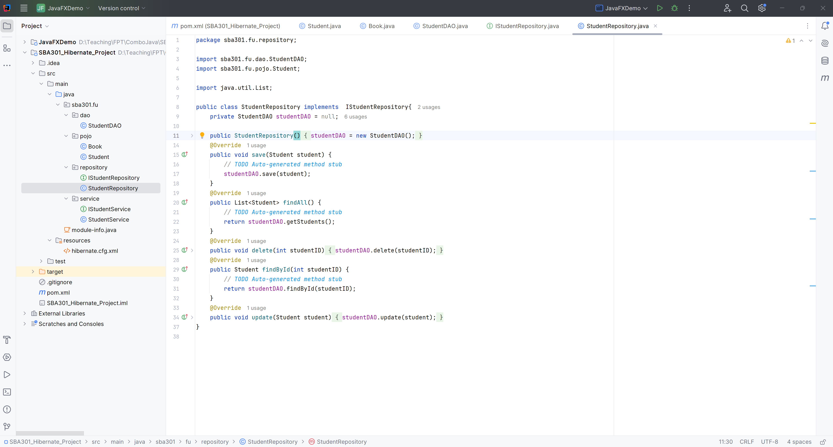
Create StudentRepository

Slide 17
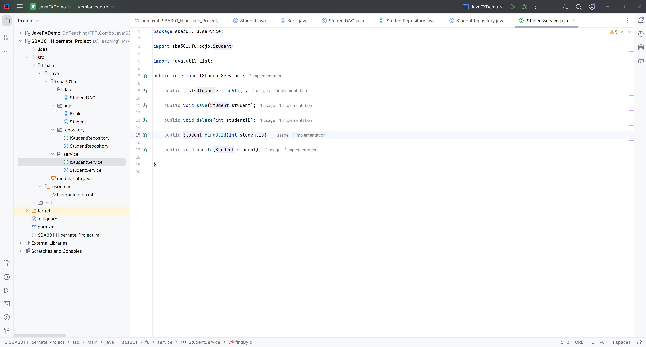
Create IStudentService

Slide 18
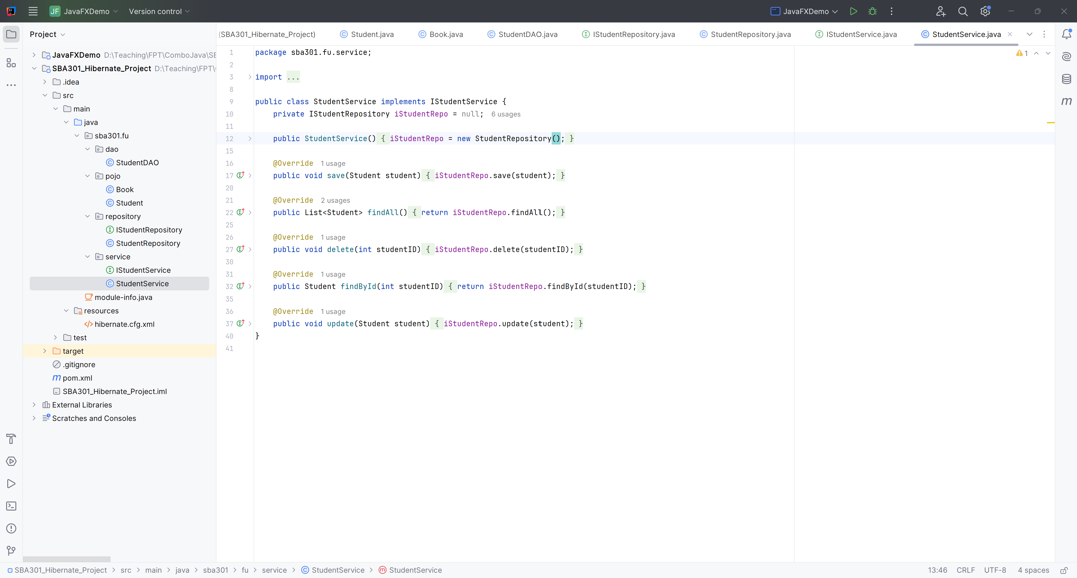
Create StudentService

Slide 19
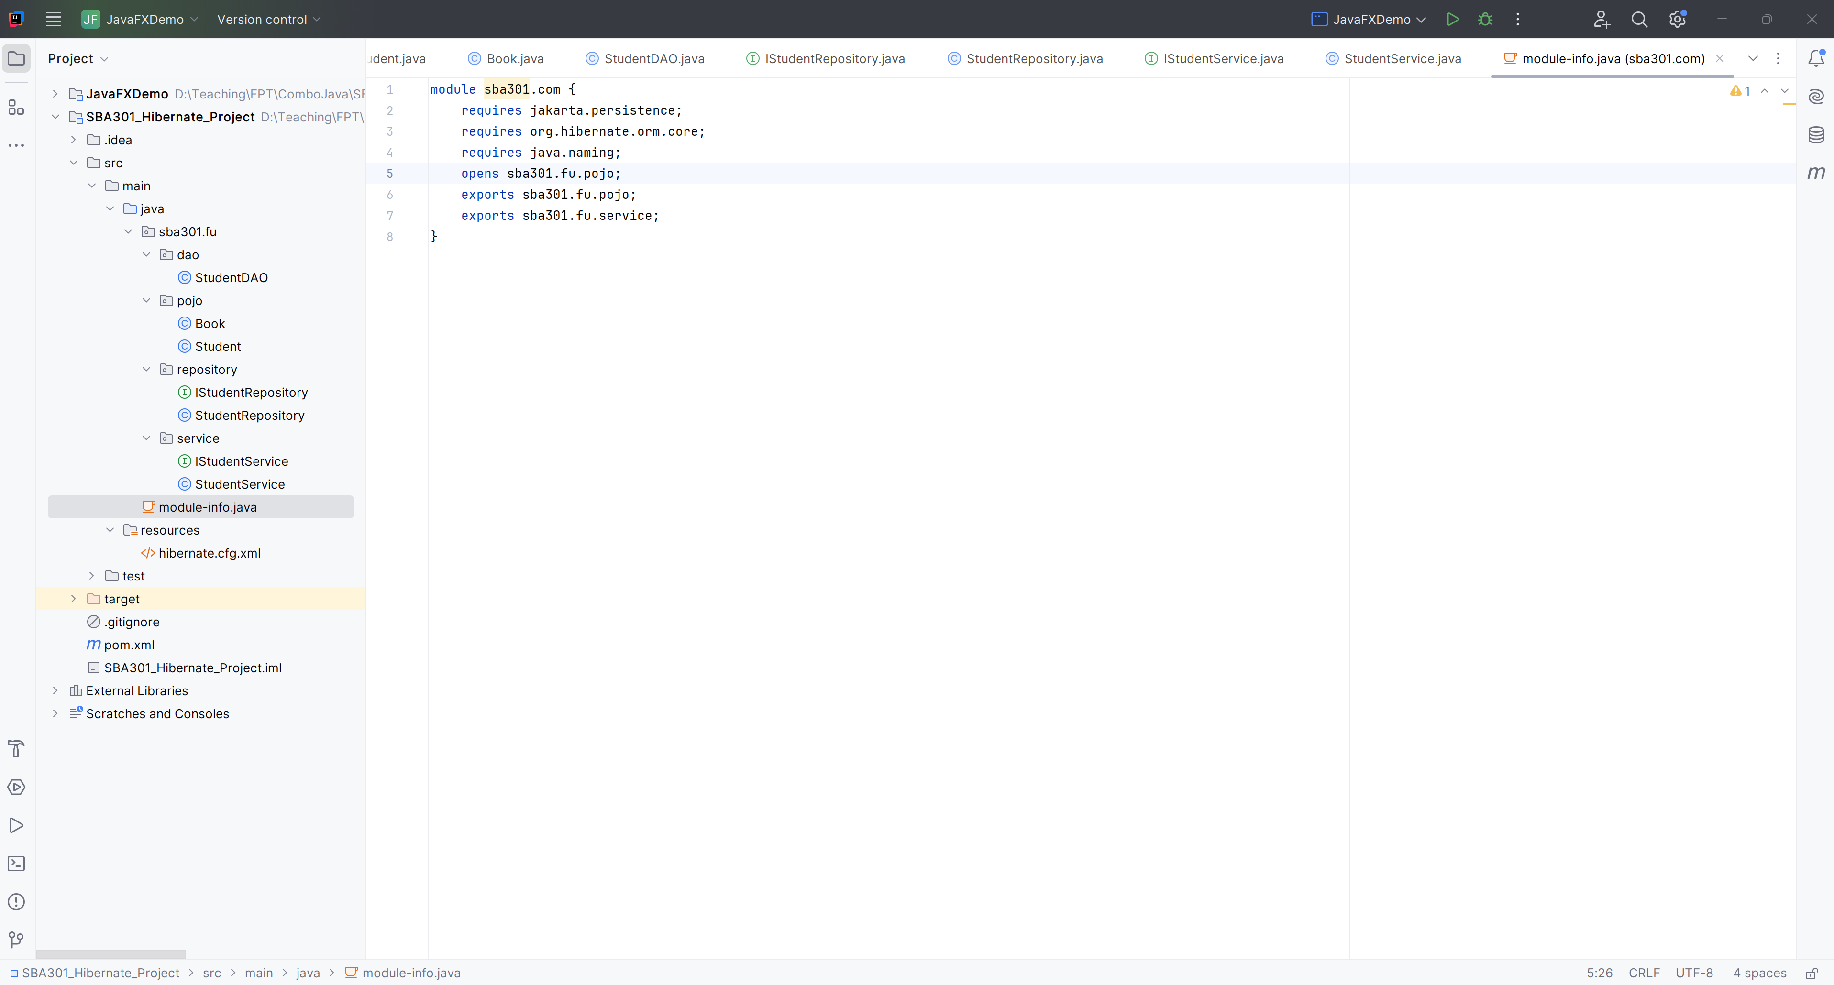
Create module-info.java

Slide 20
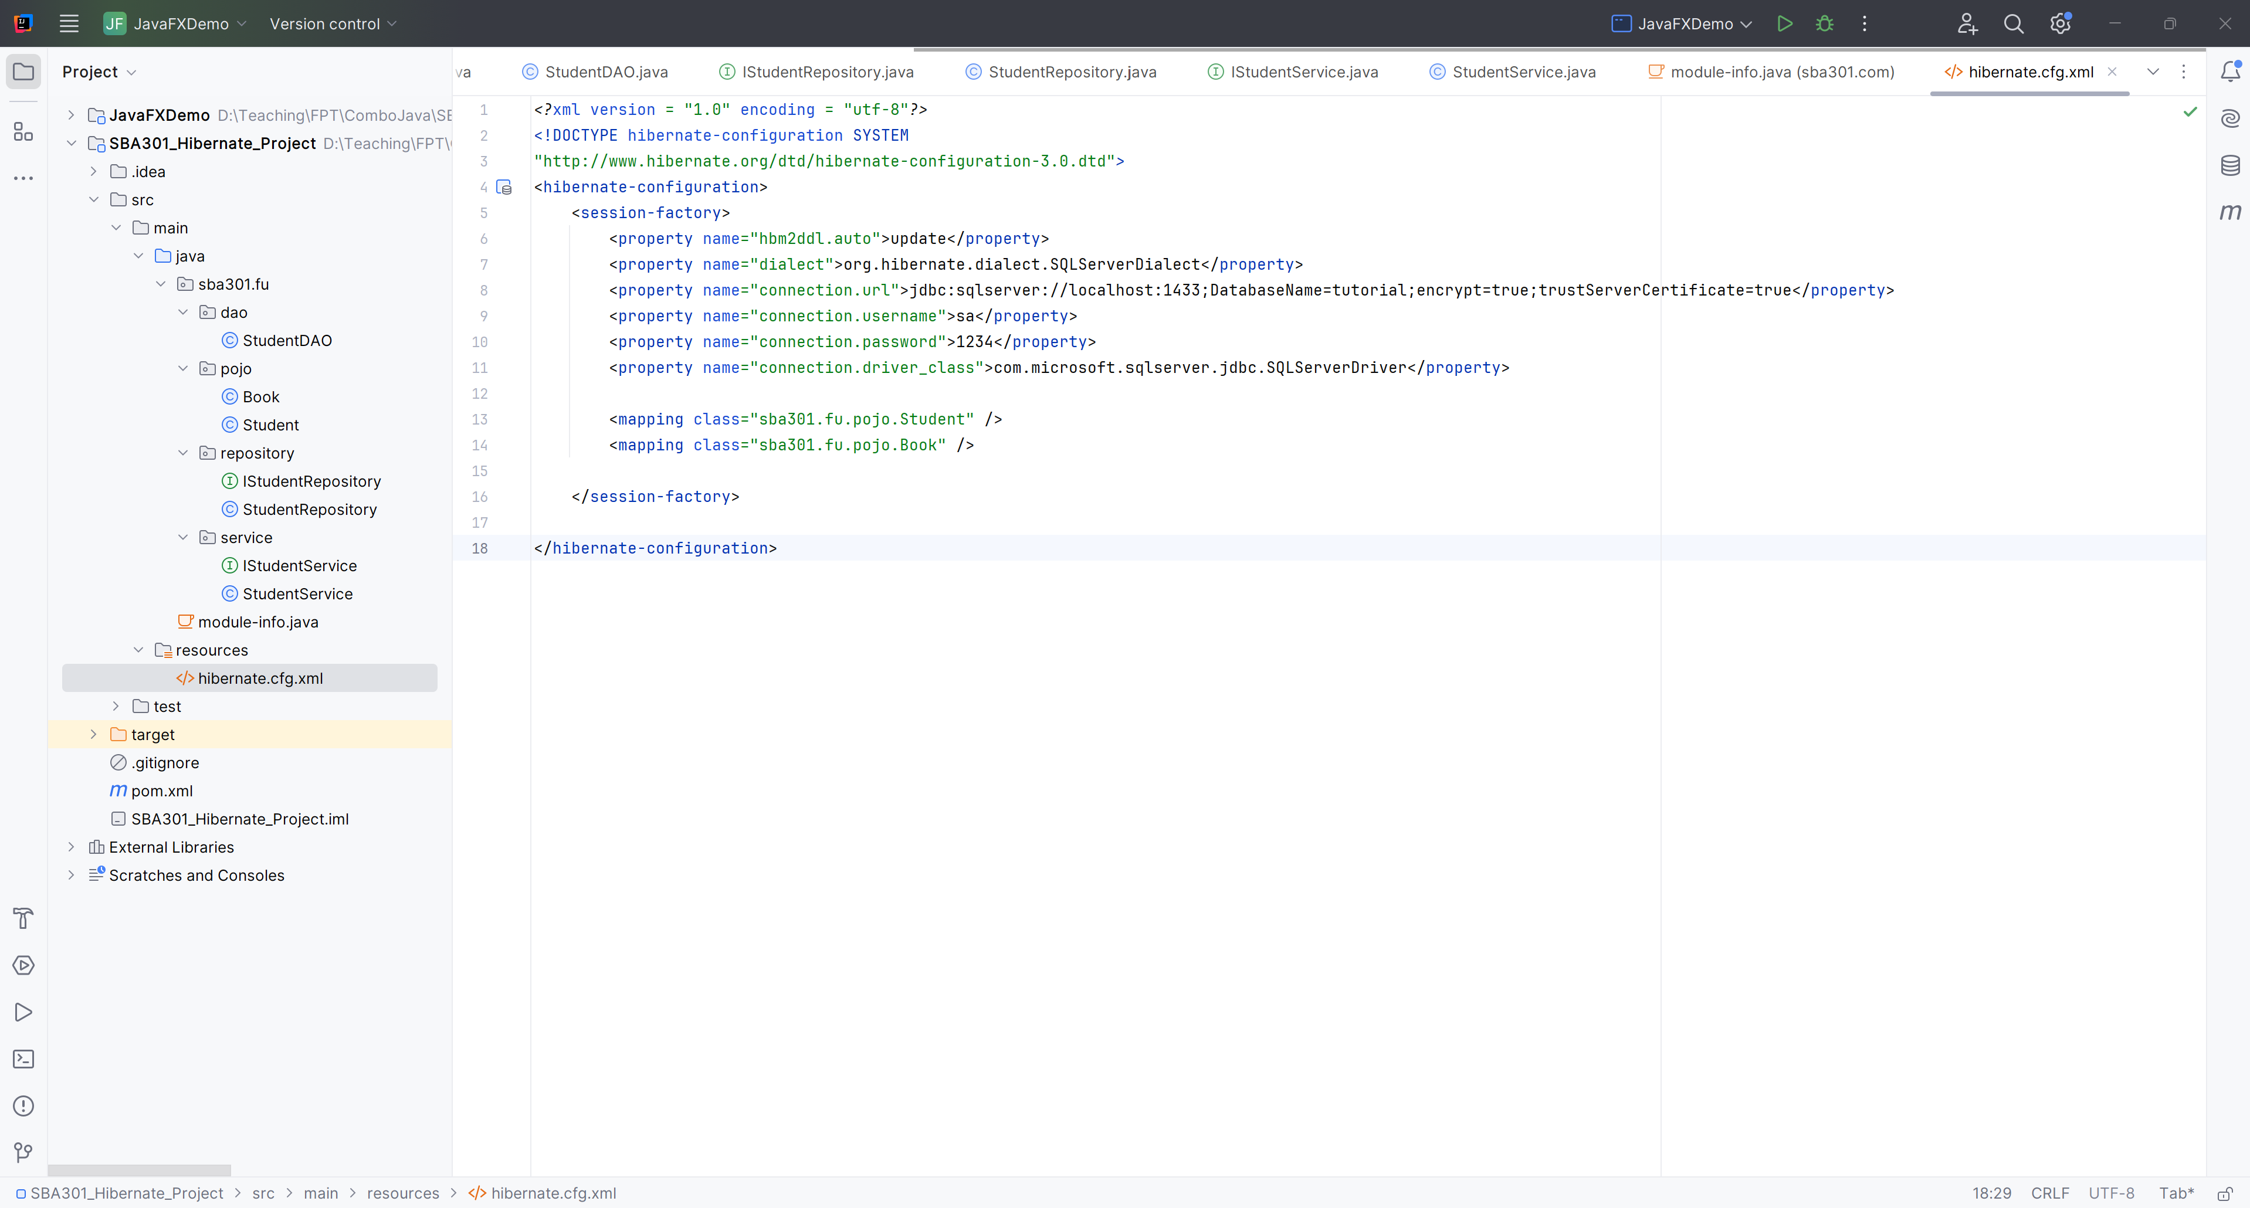
Create hibernate.cfg.xml

Slide 21
Design GUI Application with JavaFX

Slide 22
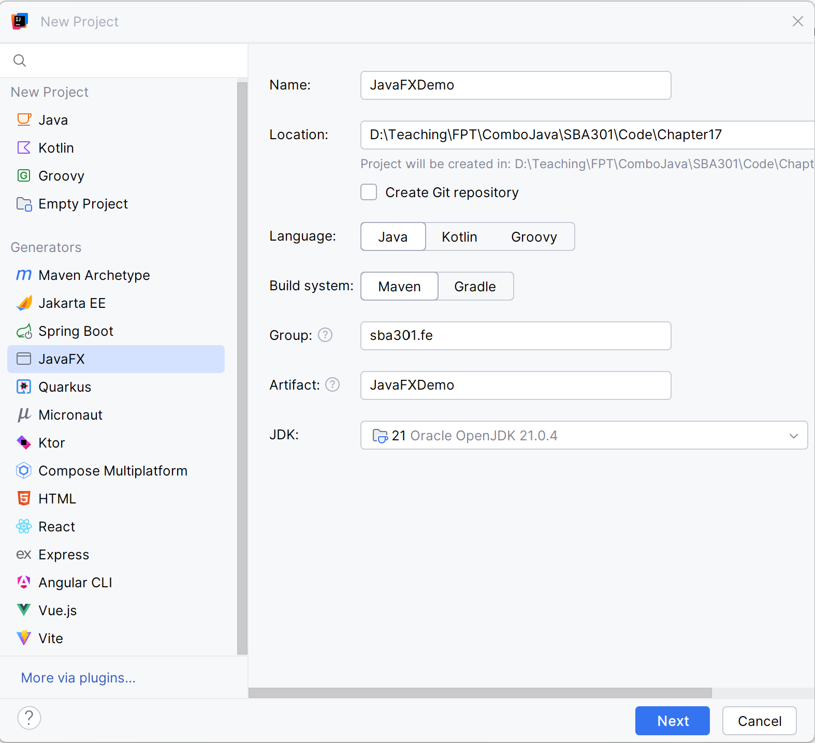
Open IntelliJ, File | New | Maven Project

Slide 23
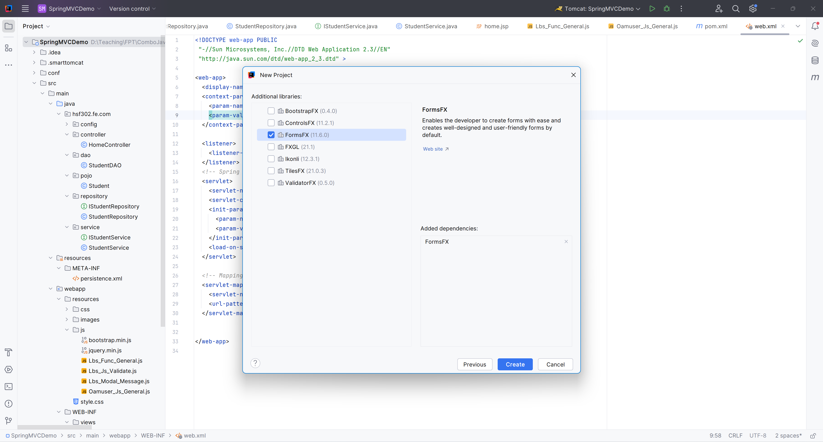
Check FormFX

Slide 24
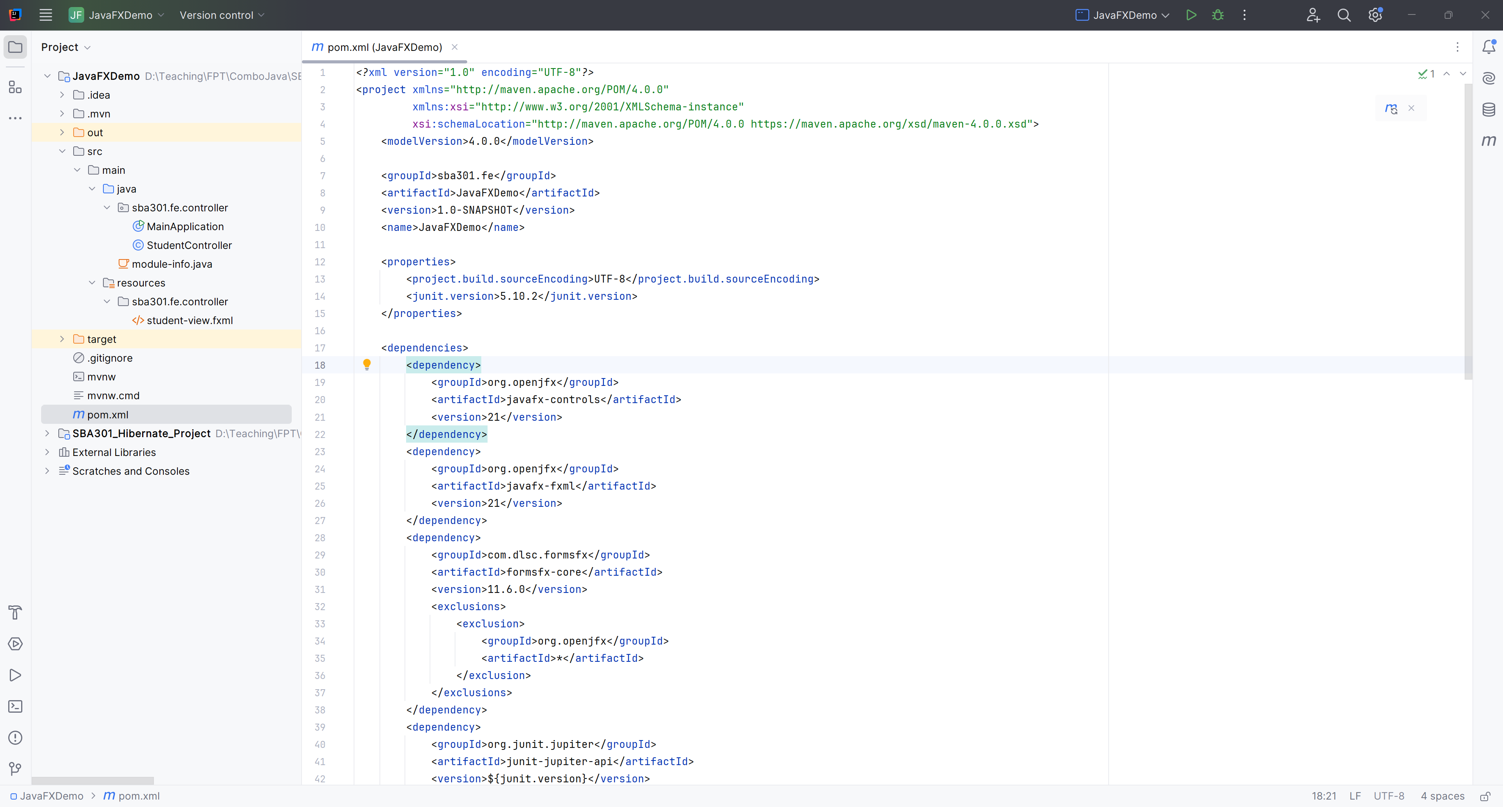
Build the Architecture

Slide 25
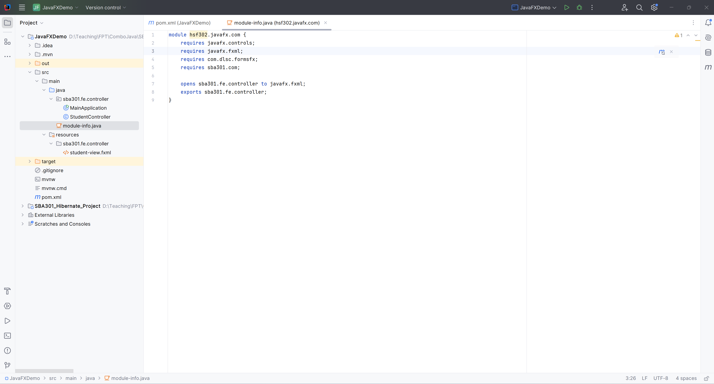
Edit module-info.java in JavaFXDemo

Slide 26
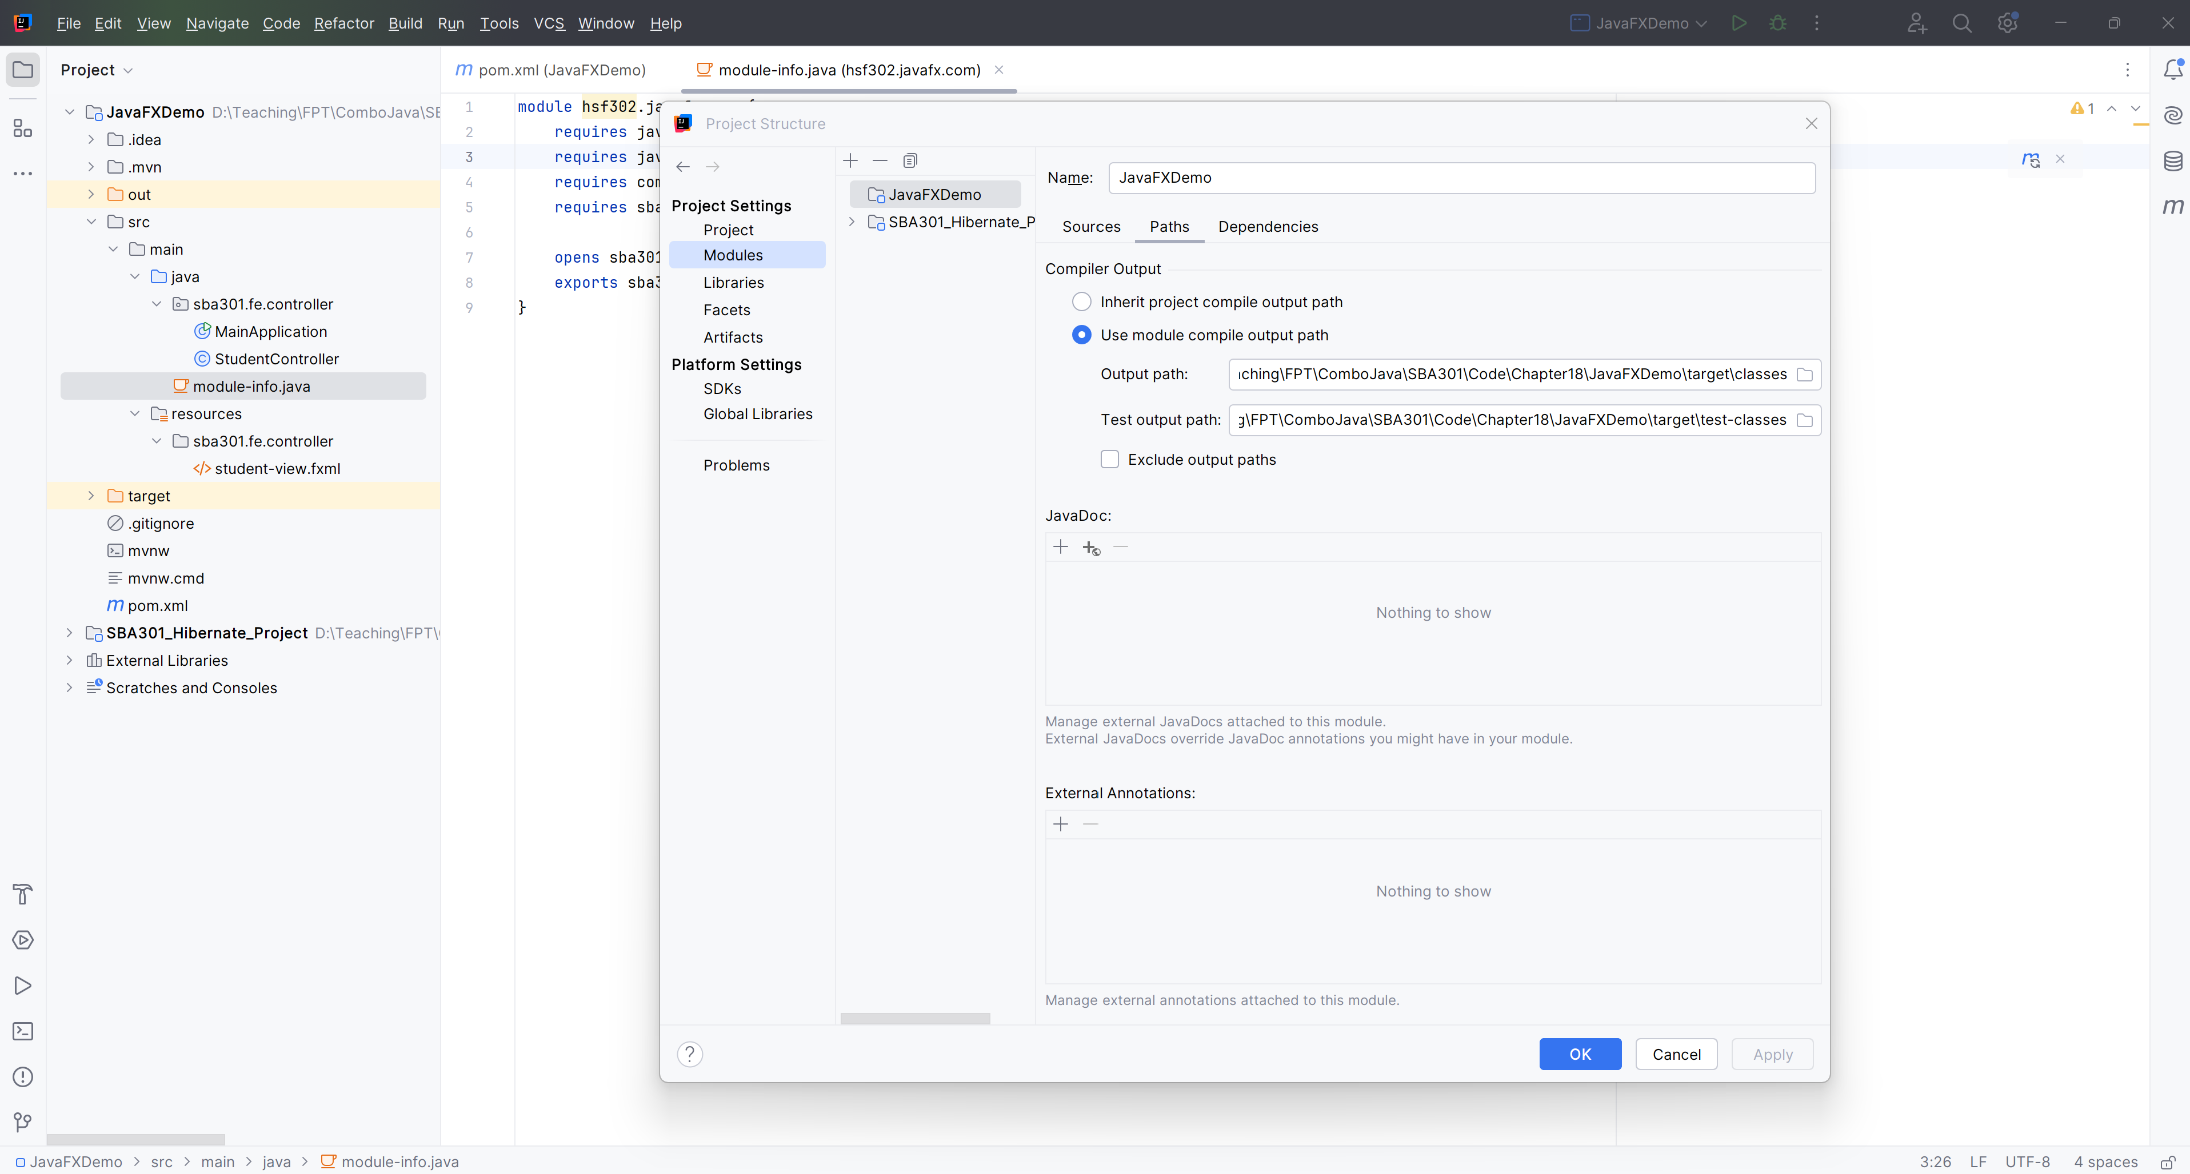
Add Reference Another Project

Slide 27
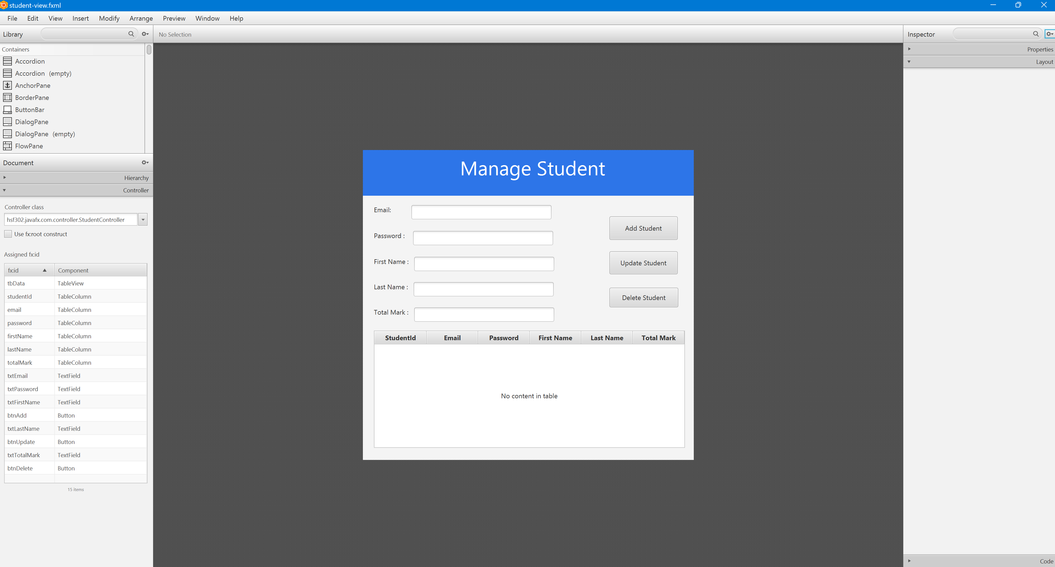
Open Student-view.fxml in SceneBuilder

Slide 28
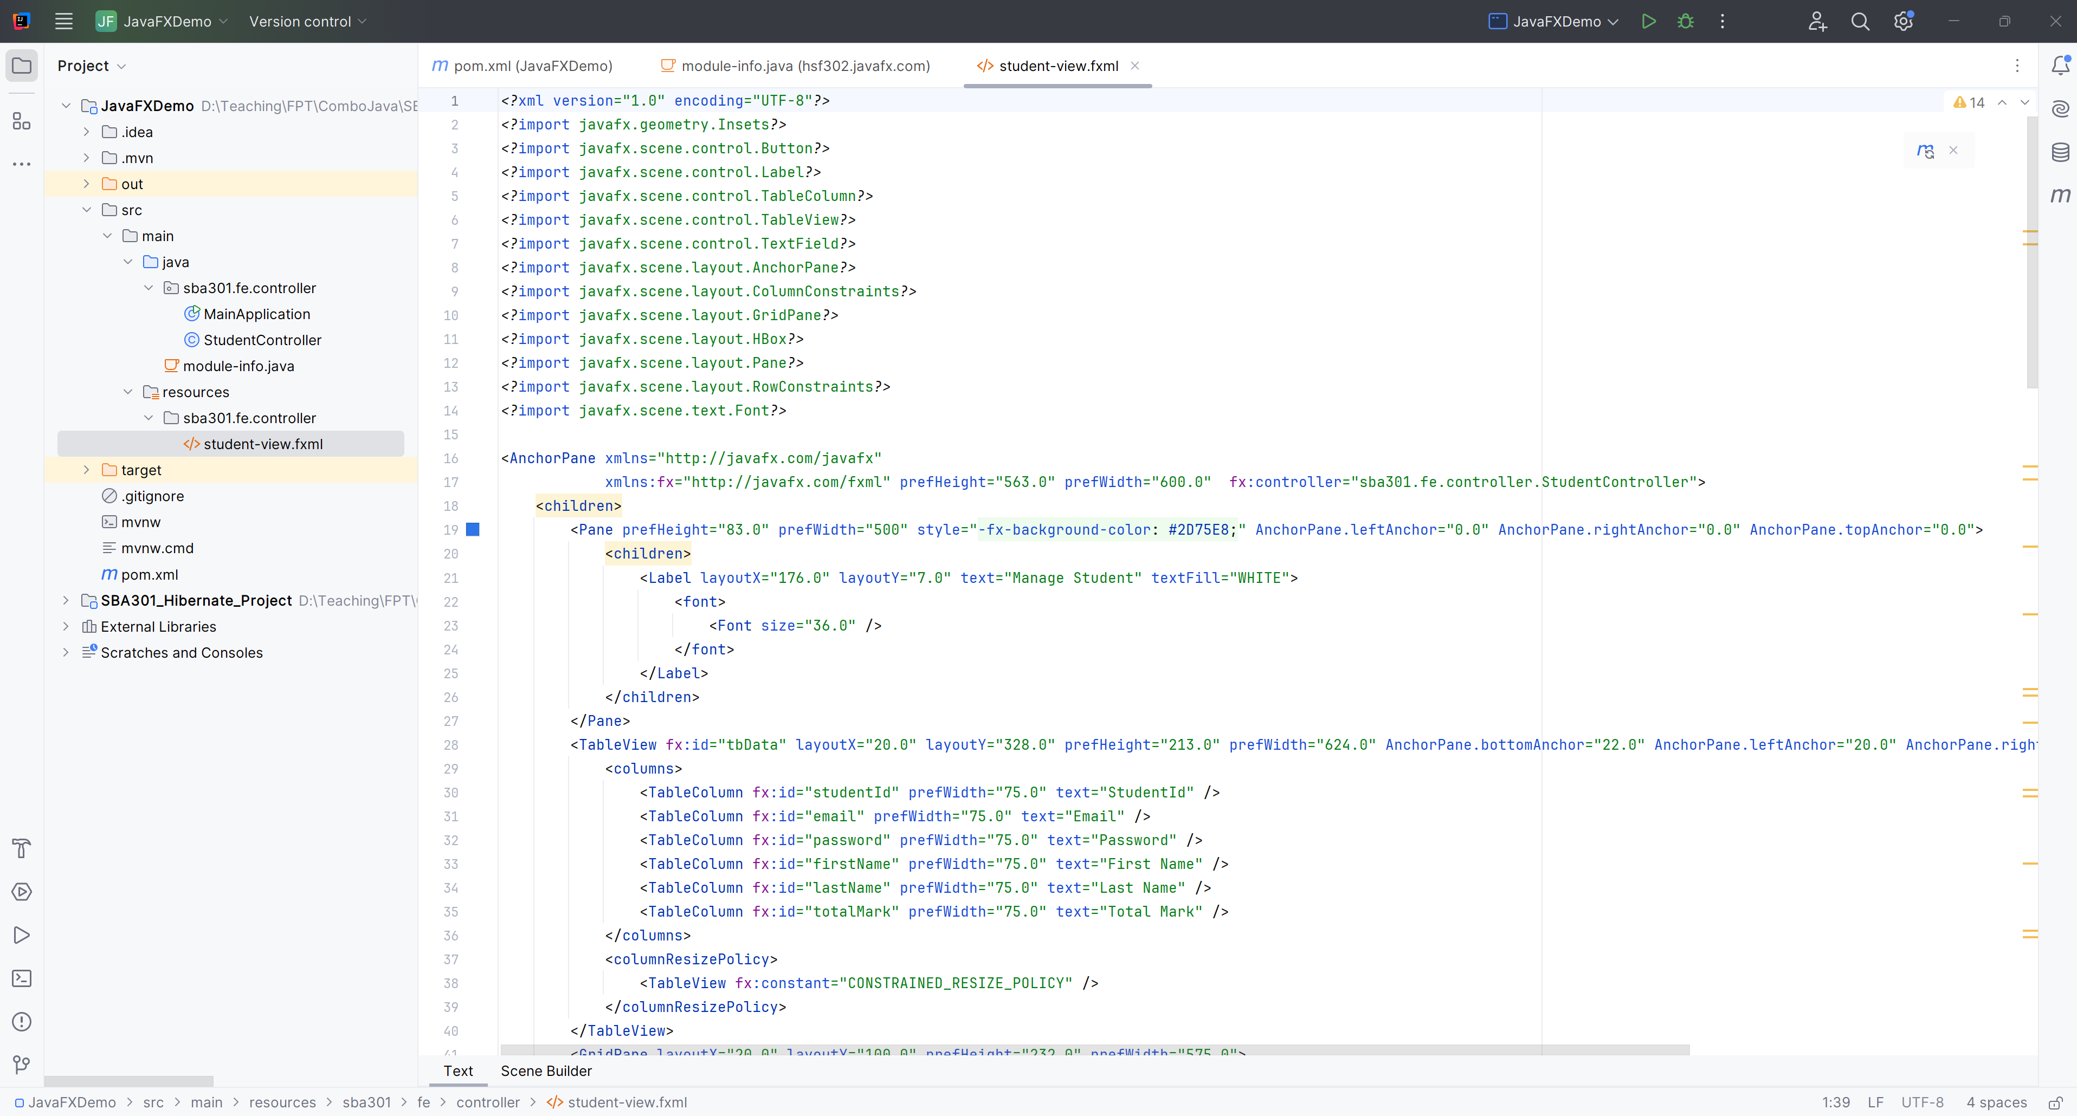
Edit student-view.fxml

Slide 29
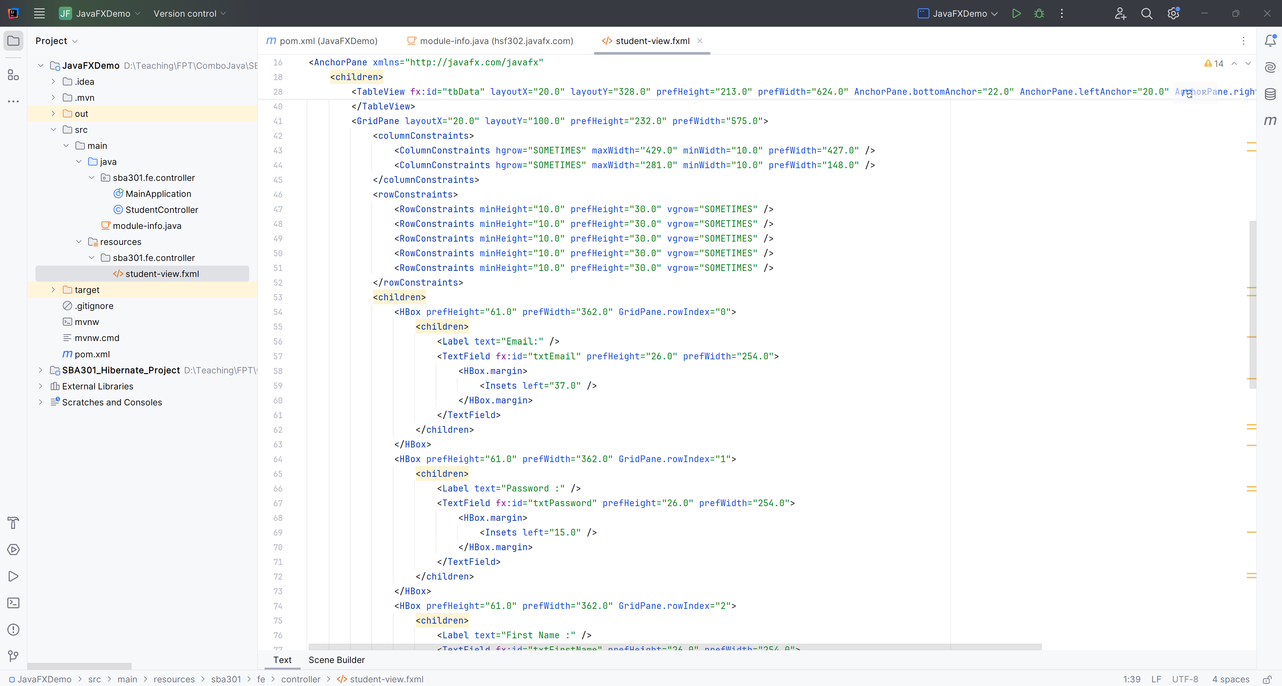
Edit student-view.fxml

Slide 30
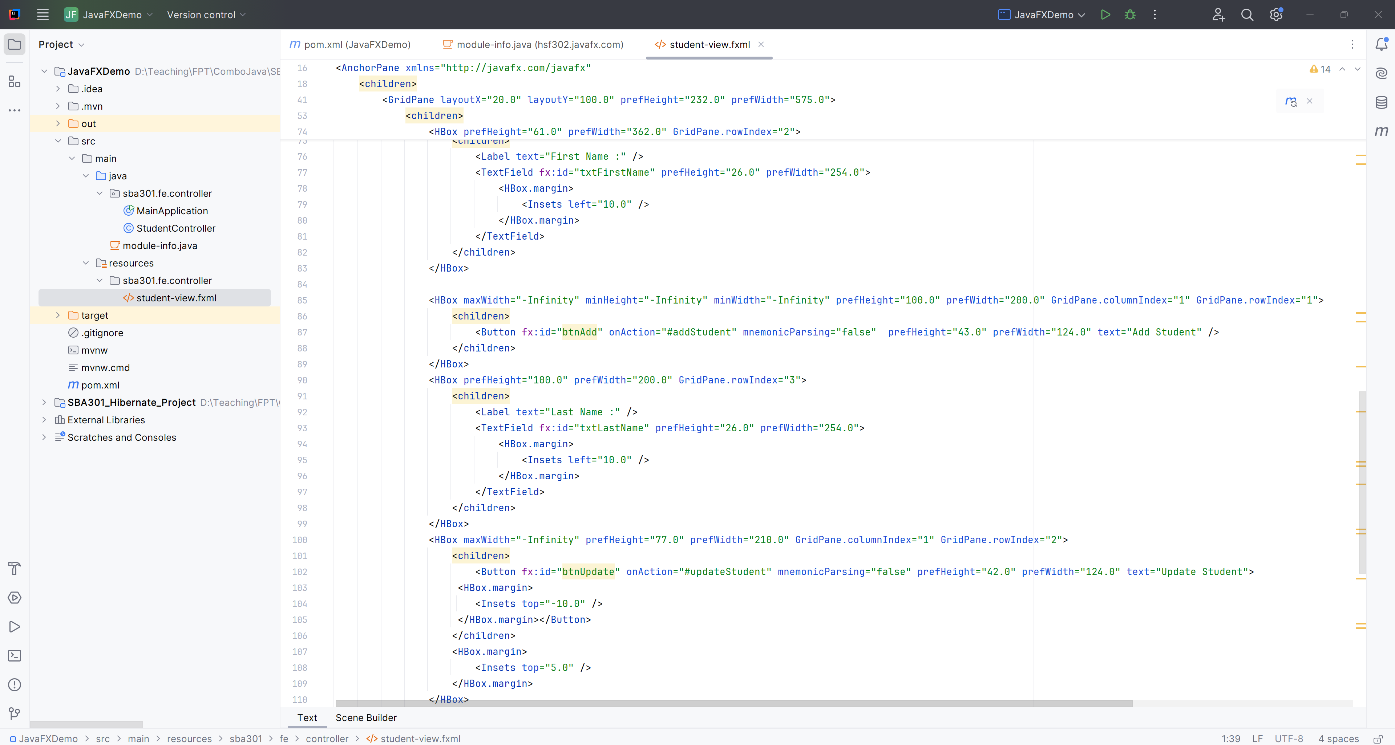
Edit student-view.fxml

Slide 31
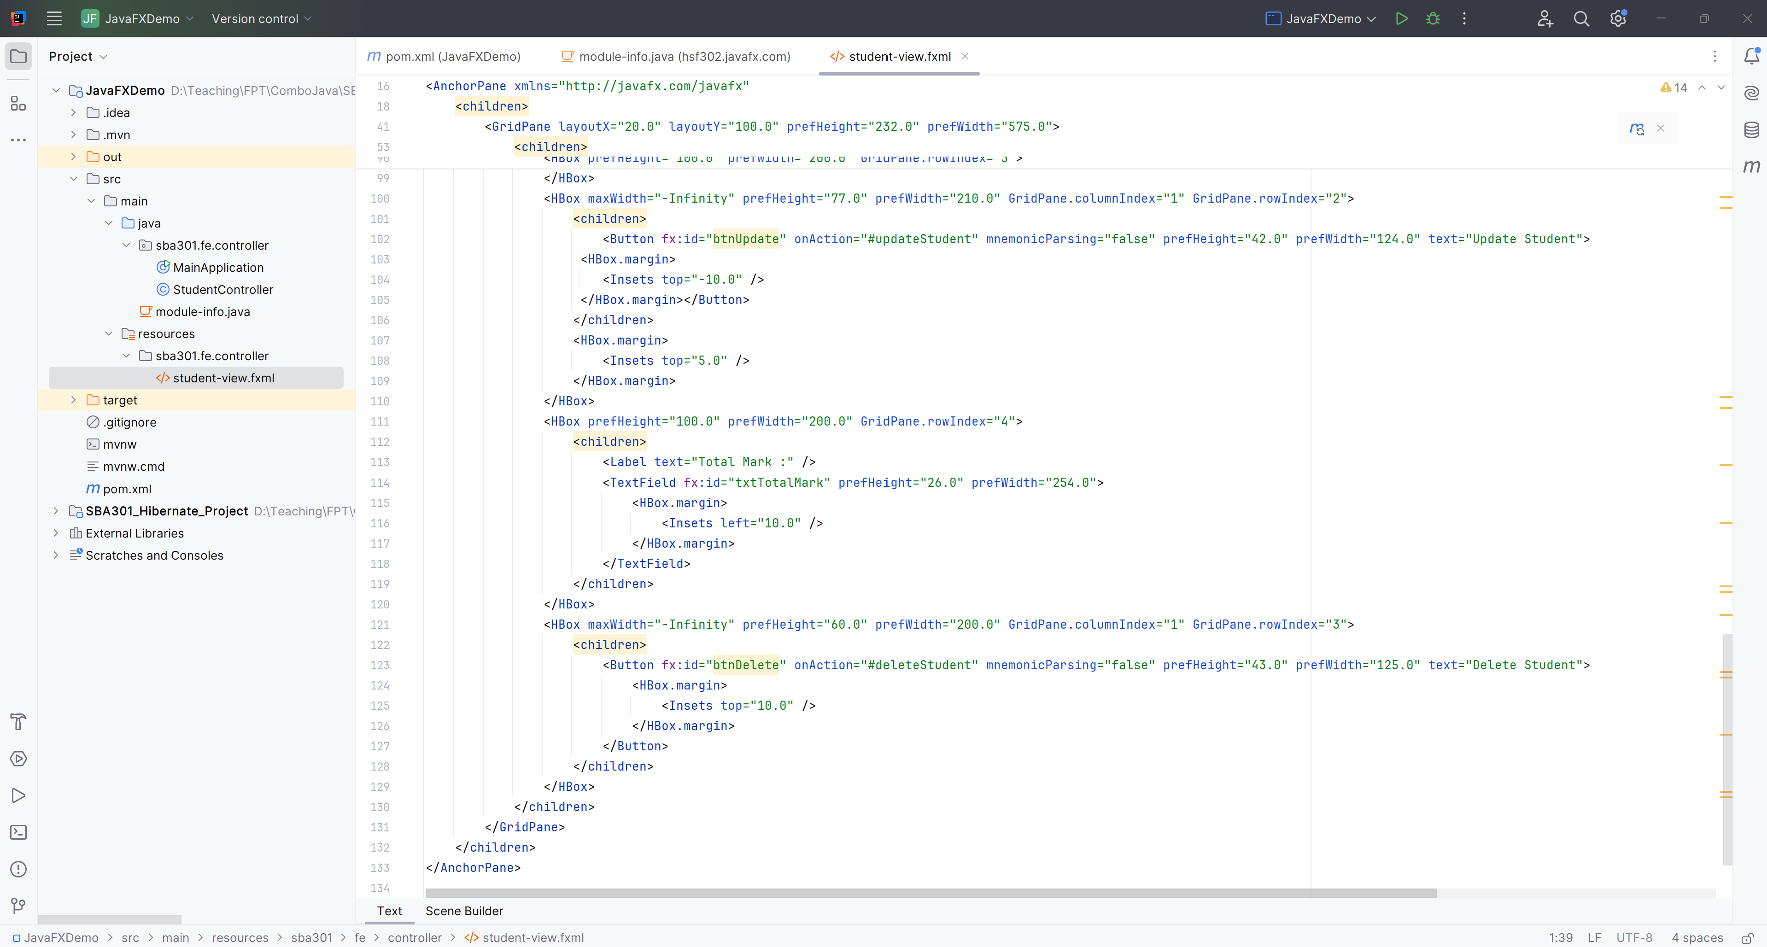
Edit student-view.fxml

Slide 32
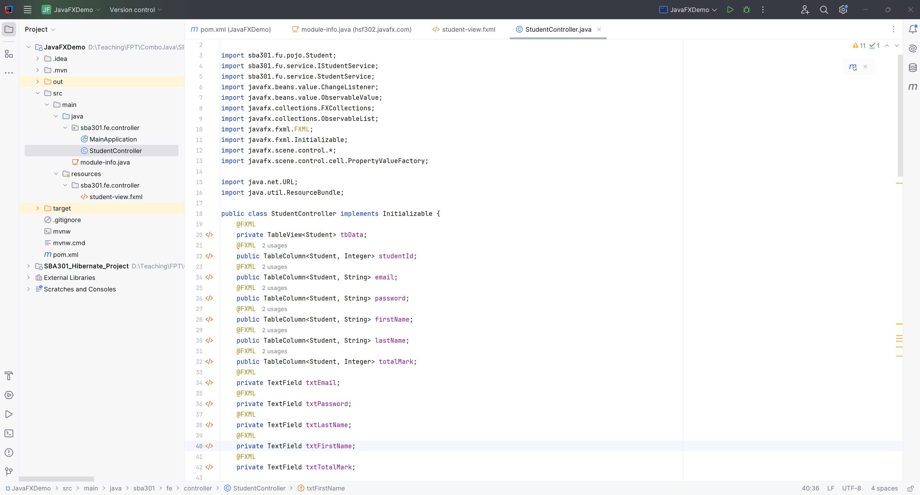
Edit the StudentController.java

Slide 33
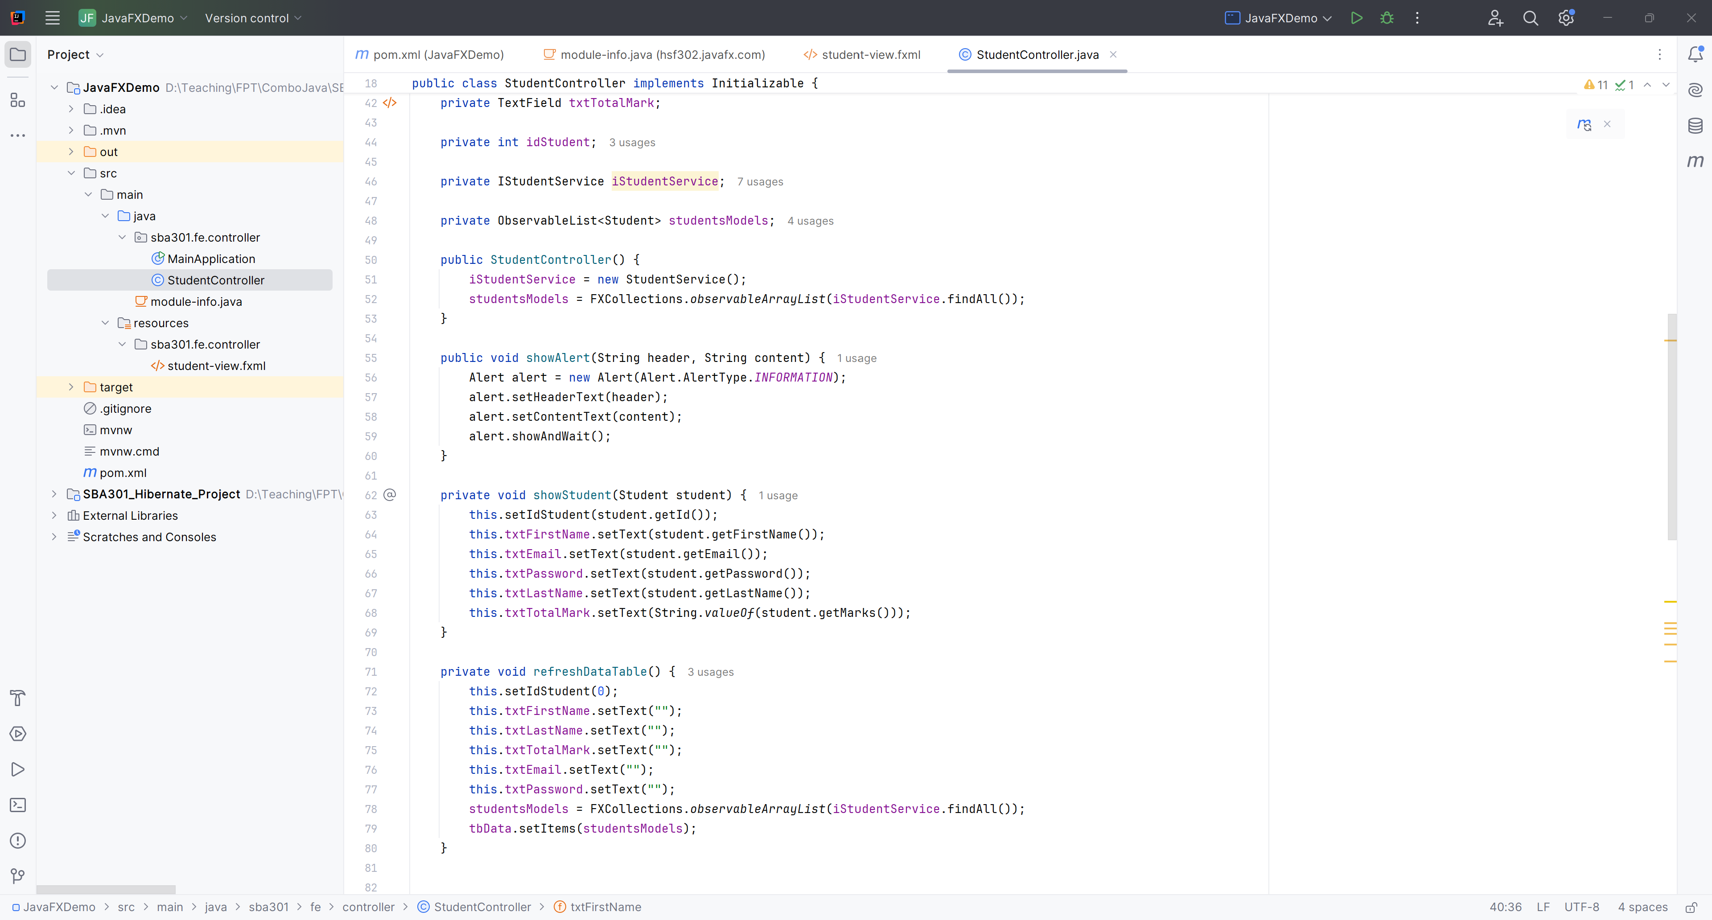
Edit the StudentController.java

Slide 34
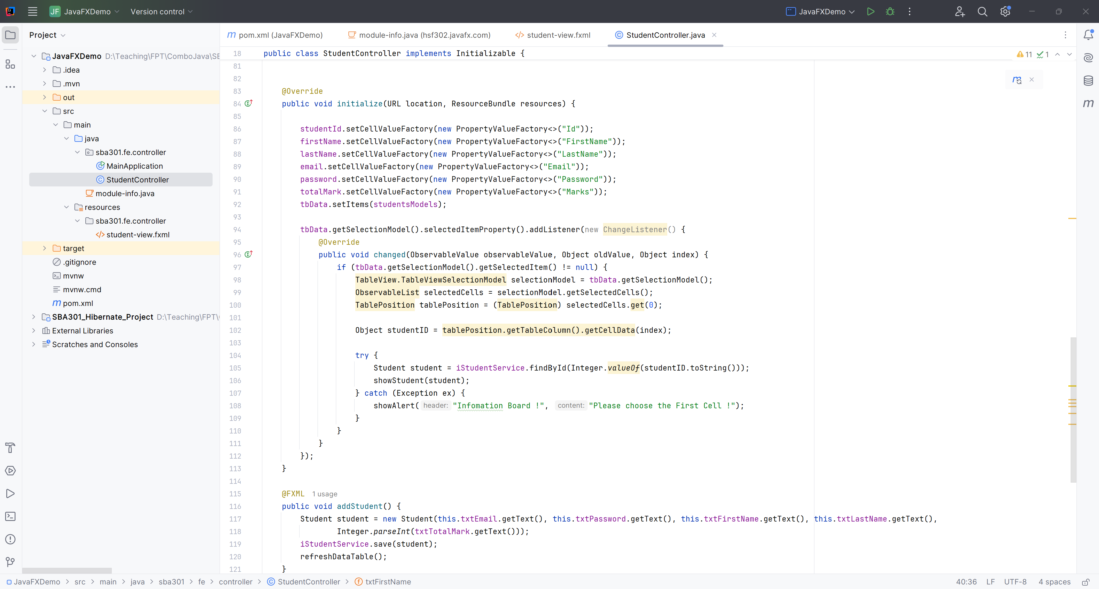
Edit the StudentController.java

Slide 35
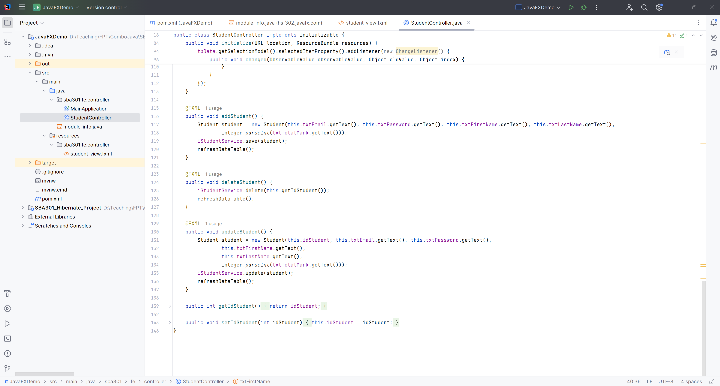
Edit the StudentController.java

Slide 36
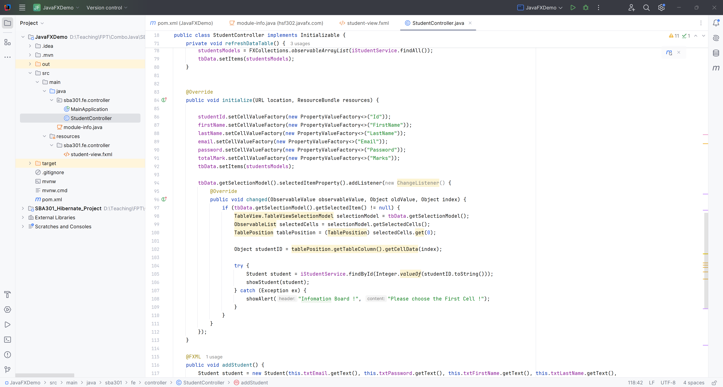
Show all student and get StudentID when click first cell

Slide 37
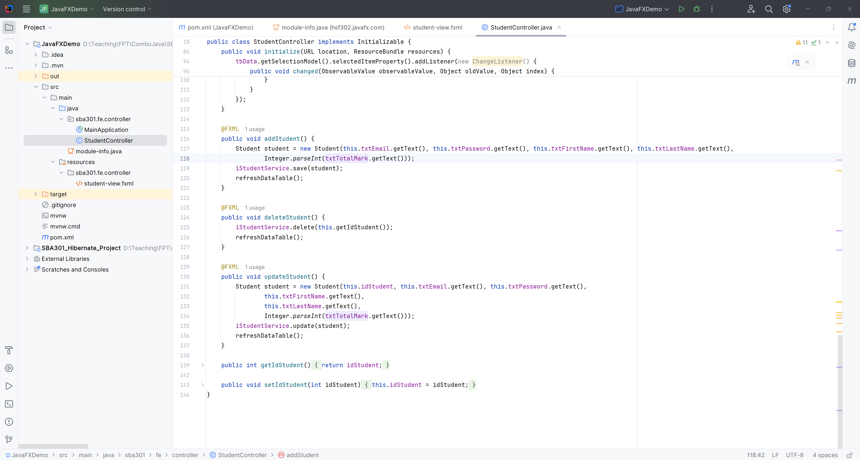
CRUD for Students

Slide 38
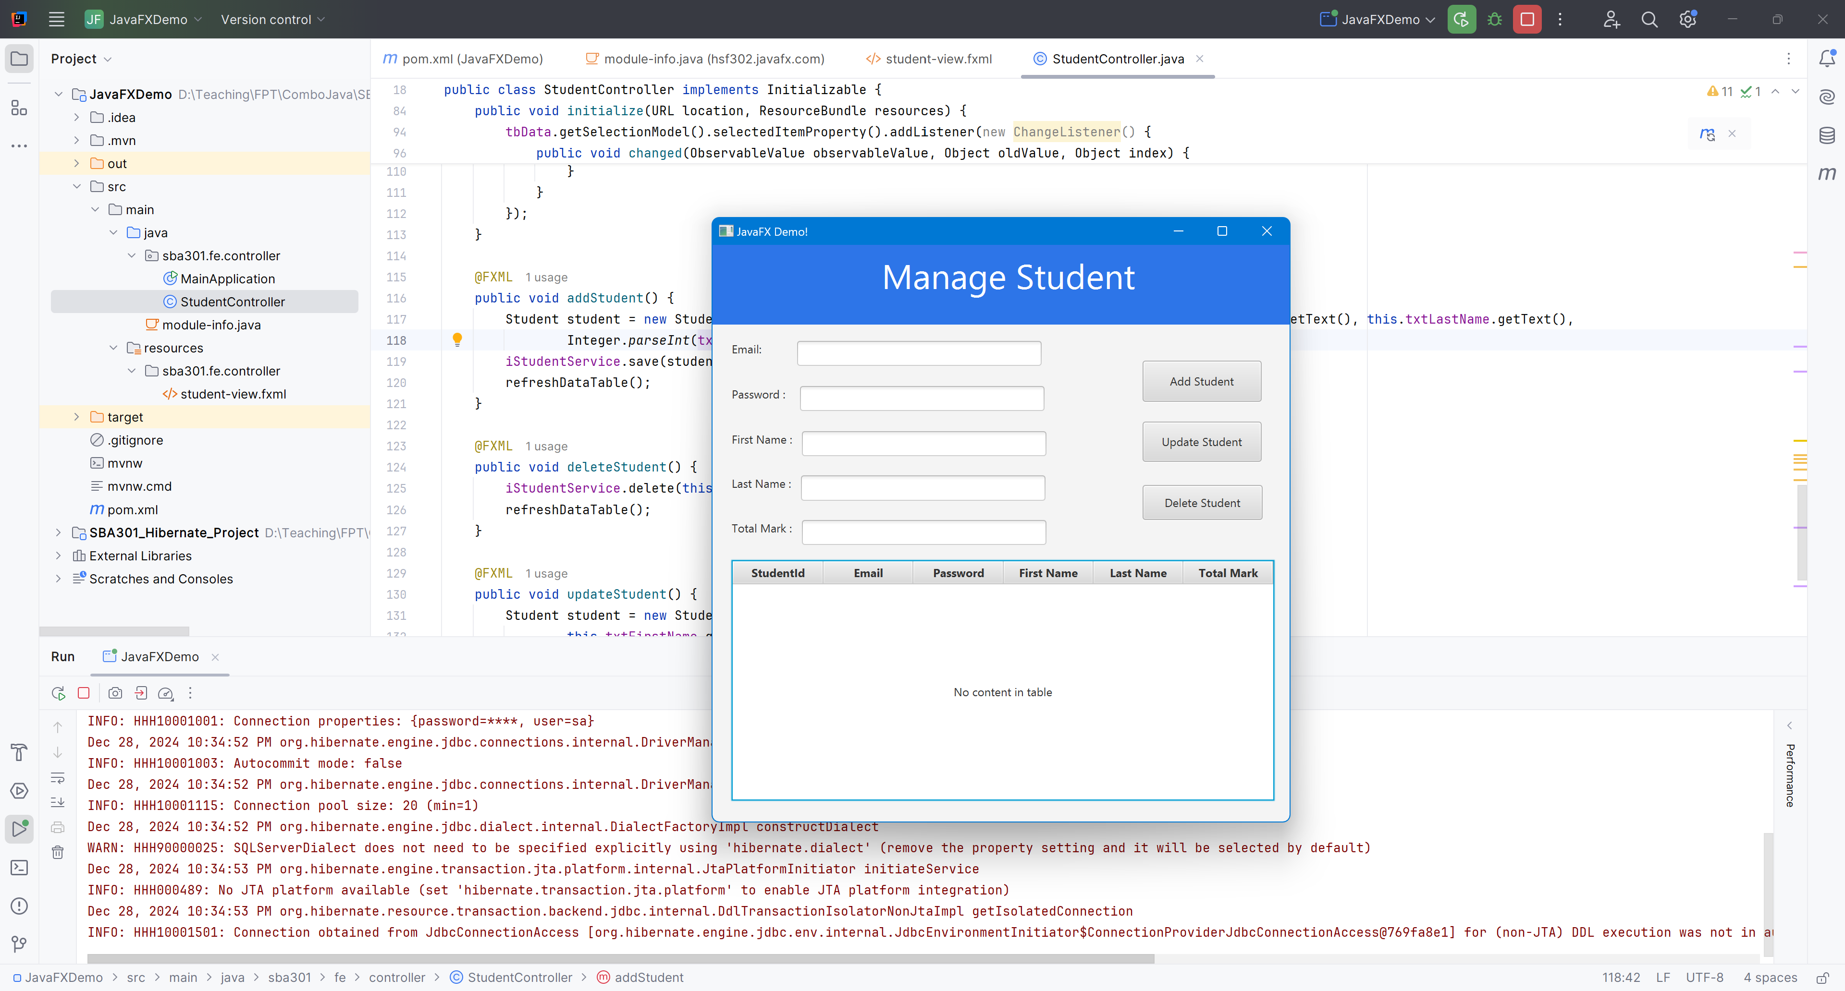
Run Project

Slide 39
Summary
Concepts were introduced:
Implement CRUD (Create, Read, Update, Delete) operations to manage data effectively.
Utilize Hibernate to map Java objects to database tables, simplifying data persistence and retrieval.
Design and develop a user-friendly interface using JavaFX, enabling seamless interaction with the application.
Implement features such as form input validation, error handling, and feedback mechanisms to enhance user experience.

